Slide 1

Lecture 1: Build your working environment
COSC 426/526: Introduction to Data Mining

Slide 2




Instructor:
Assistants to the Instructor:
GTA
Ian Lumsden
Nigel Tan
Brandan Roachell
Michela Taufer
Paula Olaya

Slide 3
Build your working environment
We use git & GitHub to distribute & collect assignments as well as other class materials (e.g., slides, code, and datasets)
Create a GitHub username (if you do not have one)
Install git and GitHub desktop on your laptop
We use Jupyter notebook for our assignments and project
Follow the steps in the file Lecutre01_student_notes to install Jupyter
We use XSEDE Jetstream as our cloud platform for assignments and the semester project
Introduce its use in the 3rd lecture
Create accounts and provide you with access to the cloud in the 4th lecture
3

Slide 4
GitHub and Git
GitHub: web-based hosting service for version control
Use it to distribute and collect assignments, to share class materials (e.g., slides, codes, and datasets)
Provide us with your GitHub username
Git: software used by GitHub
Install git on your laptop
Class GitHub Repository:
Clone the course repository
https://github.com/CISC879-BigData/UTK-COSC426and526-S22
4

Slide 5
Git and GitHub
5

Slide 6
Version Control System
Version control system
“Version control is a system that records changes to a file or set of files over time so that you can recall specific versions later.”
Source: About Version Control – Git; git-scm.com › Getting-Started-About-Version-Control
Version control systems can be:
Centralized
Distributed
6

Slide 7
Centralized and Distributed Version Control System
Centralized
Distributed
Server
Server
Repository
Repository
commit
commit
push
push
update
update
pull
pull
Working Copy
Working Copy
Repository
Repository
commit
commit
Workstation 1
Workstation 1
update
update
Working Copy
Working Copy
Workstation 1
Workstation 1
Source: https://www.geeksforgeeks.org/version-control-systems/

Slide 8
Why we use Version Control System
Multiple people can work simultaneously on a single project
Everyone works on and edits their copy of the files, and it is up to them when they wish to share the changes they made with the rest of the team.
Work done simultaneously by different members of a team can be integrated
When two people make conflicting edits to the same line of a file, then human assistance is requested by the version control system in deciding what should be done.
One person can use multiple computers to work on a project
Users have access to the historical versions of a project
This is insurance against computer crashes or data loss
One can easily roll back to a previous version if any mistake is made. It is also possible to undo specific edits that too without losing the work done in the meanwhile
It can be easily known when, why, and by whom any part of a file was edited
Source: https://www.geeksforgeeks.org/version-control-systems/

Slide 9
Git and GitHub
Git: a free, open-source distributed version control system
GitHub: cloud-hosted git repositories
Material built from:
http://rogerdudler.github.io/git-guide/
https://marklodato.github.io/visual-git-guide/index-en.html
https://kbroman.org/github_tutorial/pages/init.html
https://kbroman.org/github_tutorial/pages/routine.html

Slide 10
Install git on your laptop (if you have not yet)
Windows or Mac
Download the GitHub Desktop application: https://desktop.github.com
Find GitHub's installation help here:
https://help.github.com/desktop/guides/getting-started-with-github-desktop/
Linux or Mac
Install the command-line interface (CLI) of git
Find help here: https://www.atlassian.com/git/tutorials/install-git
Log into GitHub

Slide 11
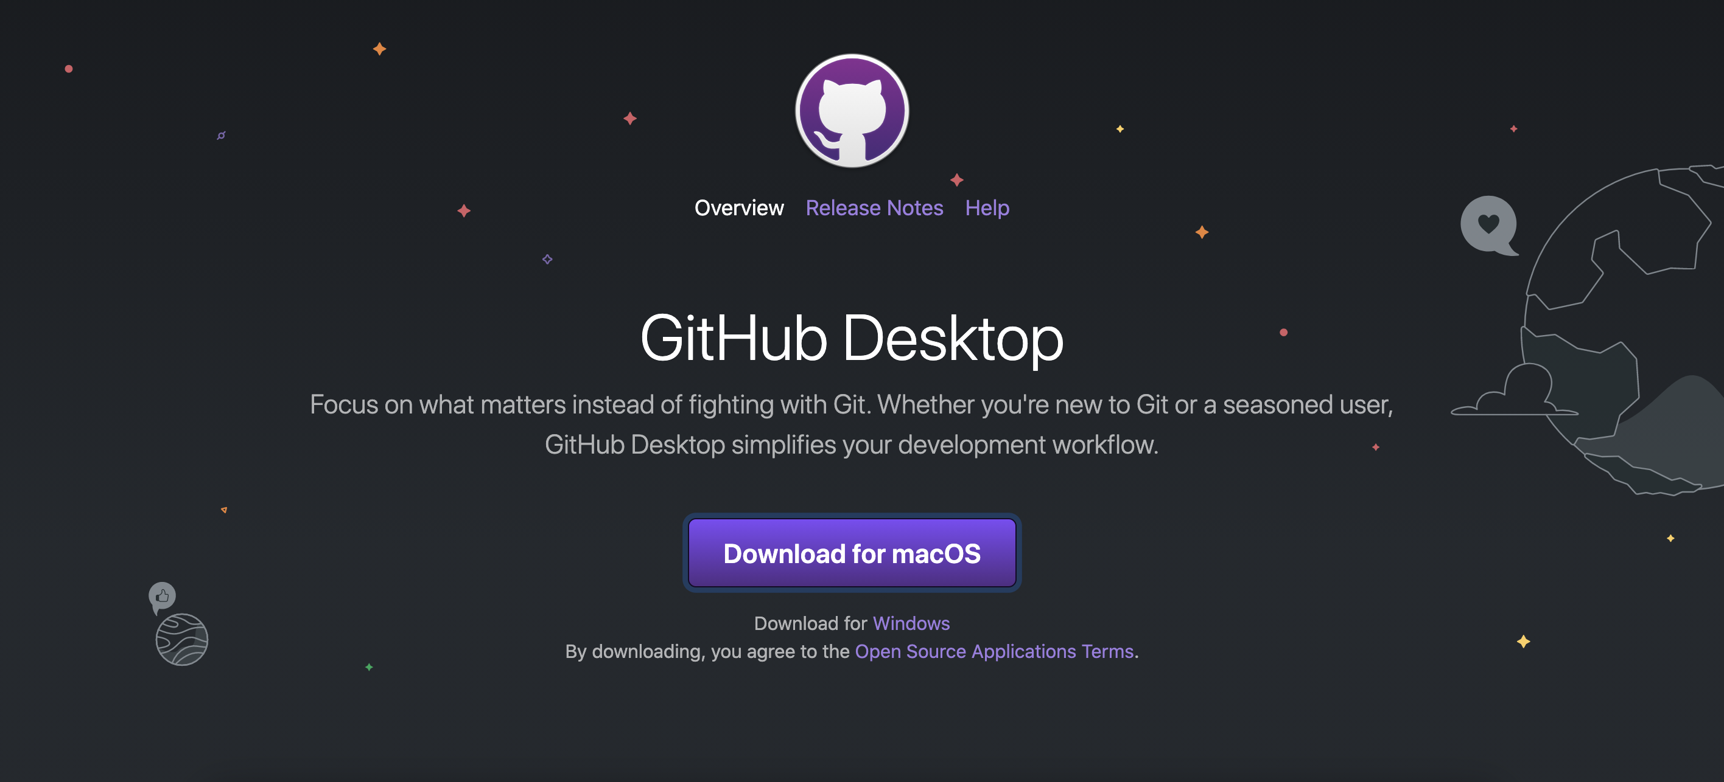
Linux or Mac
Source: https://desktop.github.com

Slide 12


Slide 13
Connect new repos to GitHub
Go to GitHub
Log in to your account
Don’t you have a GitHub account?

Slide 14
Connect new repos to github
Go to GitHub
Log in to your account
Don’t you have a GitHub account?
Get a GitHub account
Go to the GitHub Sign Up page https://github.com/join
Create a free account

Slide 15
Connect new repos to github
Go to GitHub
Log in to your account
Don’t you have a GitHub account?
Get a GitHub account
Go to the GitHub Sign Up page https://github.com/join
Create a free account
Share your GitHub account with us:
Complete form https://forms.gle/my61LrtNj1zXHkmEA

Slide 16
Use git and GitHub
The routine use of git involves just a few commands:
initiate a repository
add and commit
push and pull
status
diff
You can deal with git and GitHub via:
GitHub Desktop (GUI)
Command Line (CLI)
16

Slide 17
GitHub Desktop Application

Slide 18
18

Slide 19
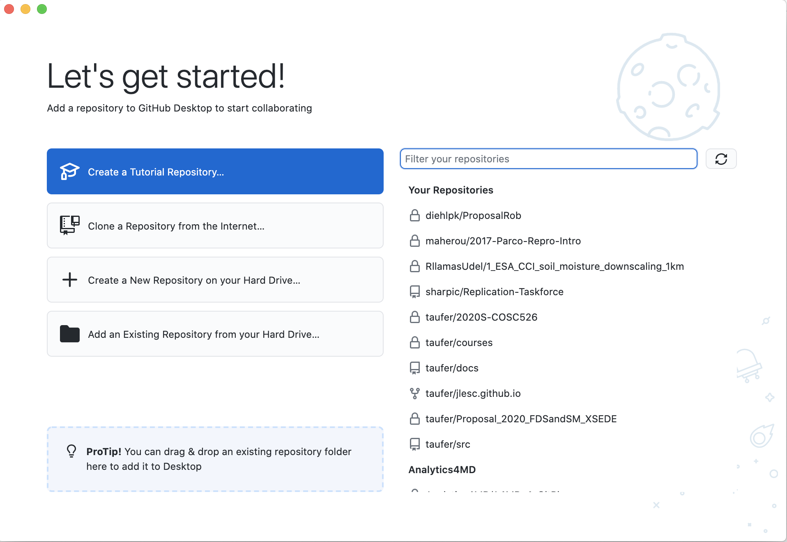
GitHub Desktop Application: Let’s start

Slide 20
GitHub Desktop Application: Let’s start

Slide 21
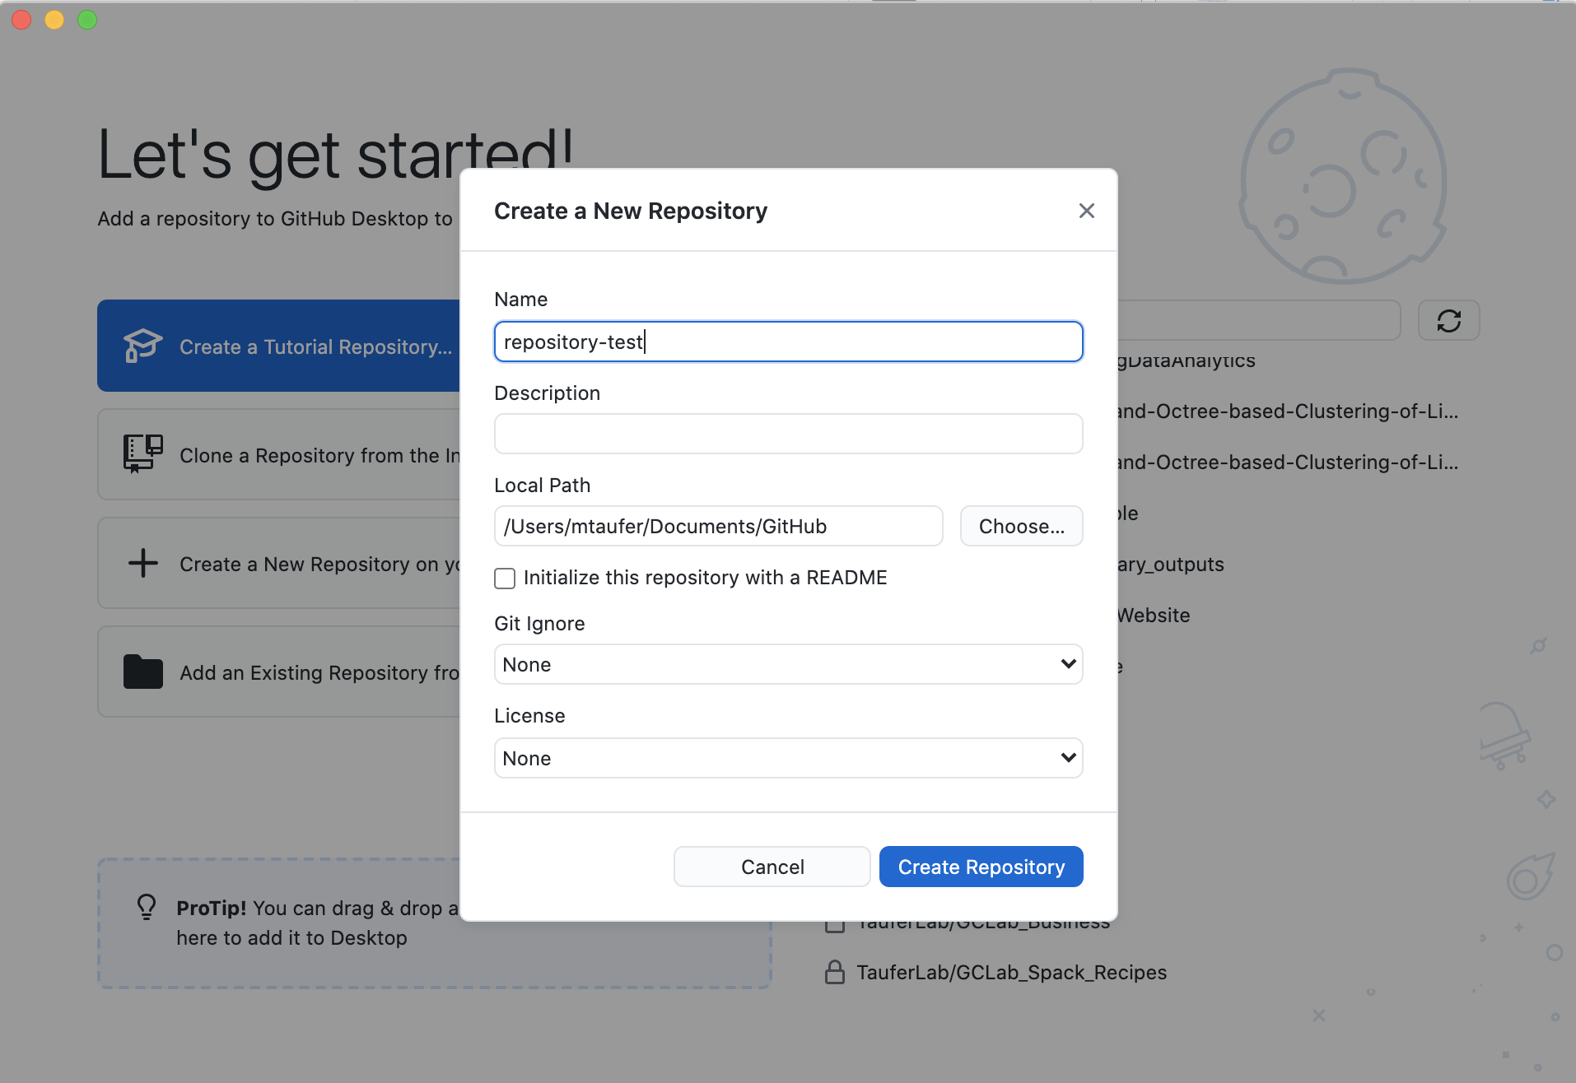
Create a Repository (I)

Slide 22
Create a Repository (II)

Slide 23
Create a Repository (III)
Your local folder

Slide 24
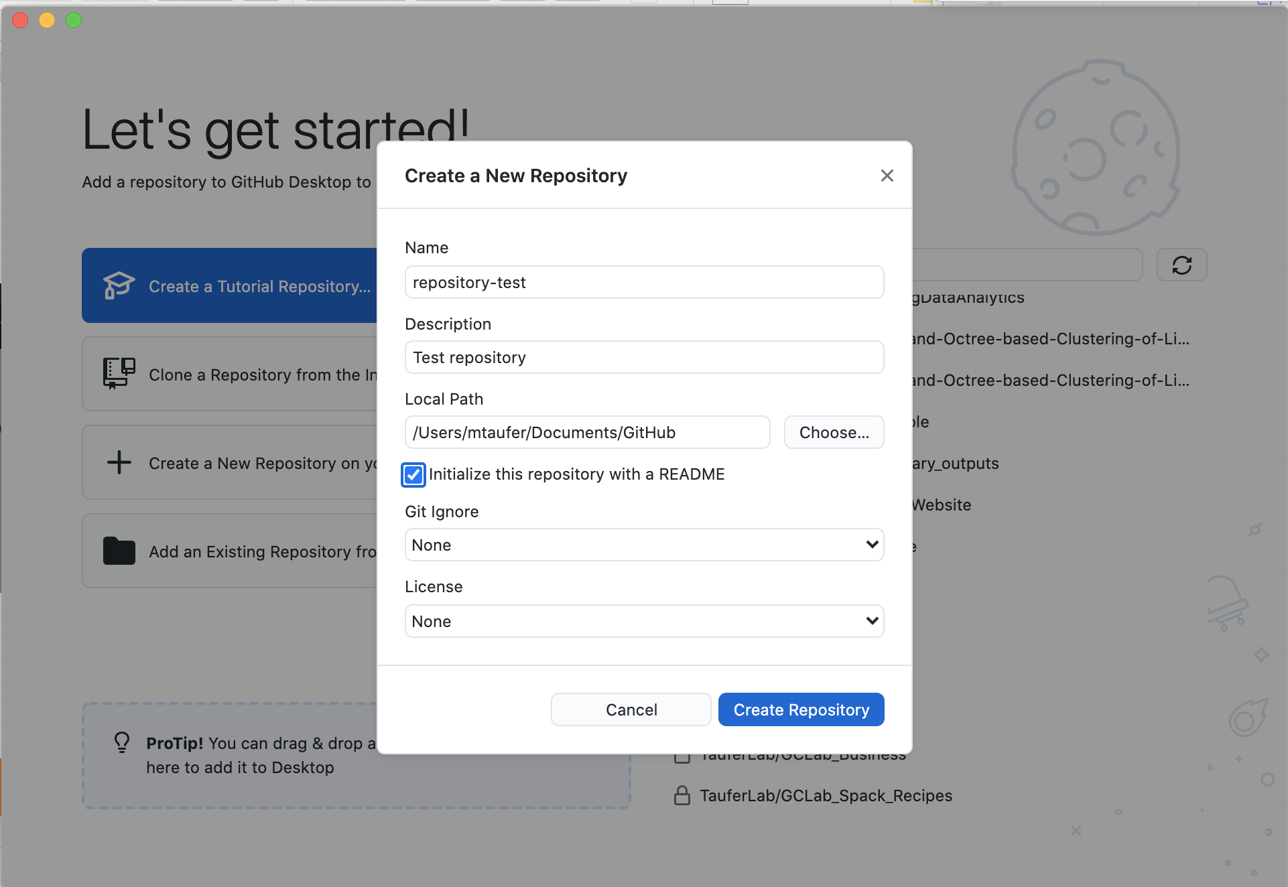
Create a Repository (IV)

Slide 25
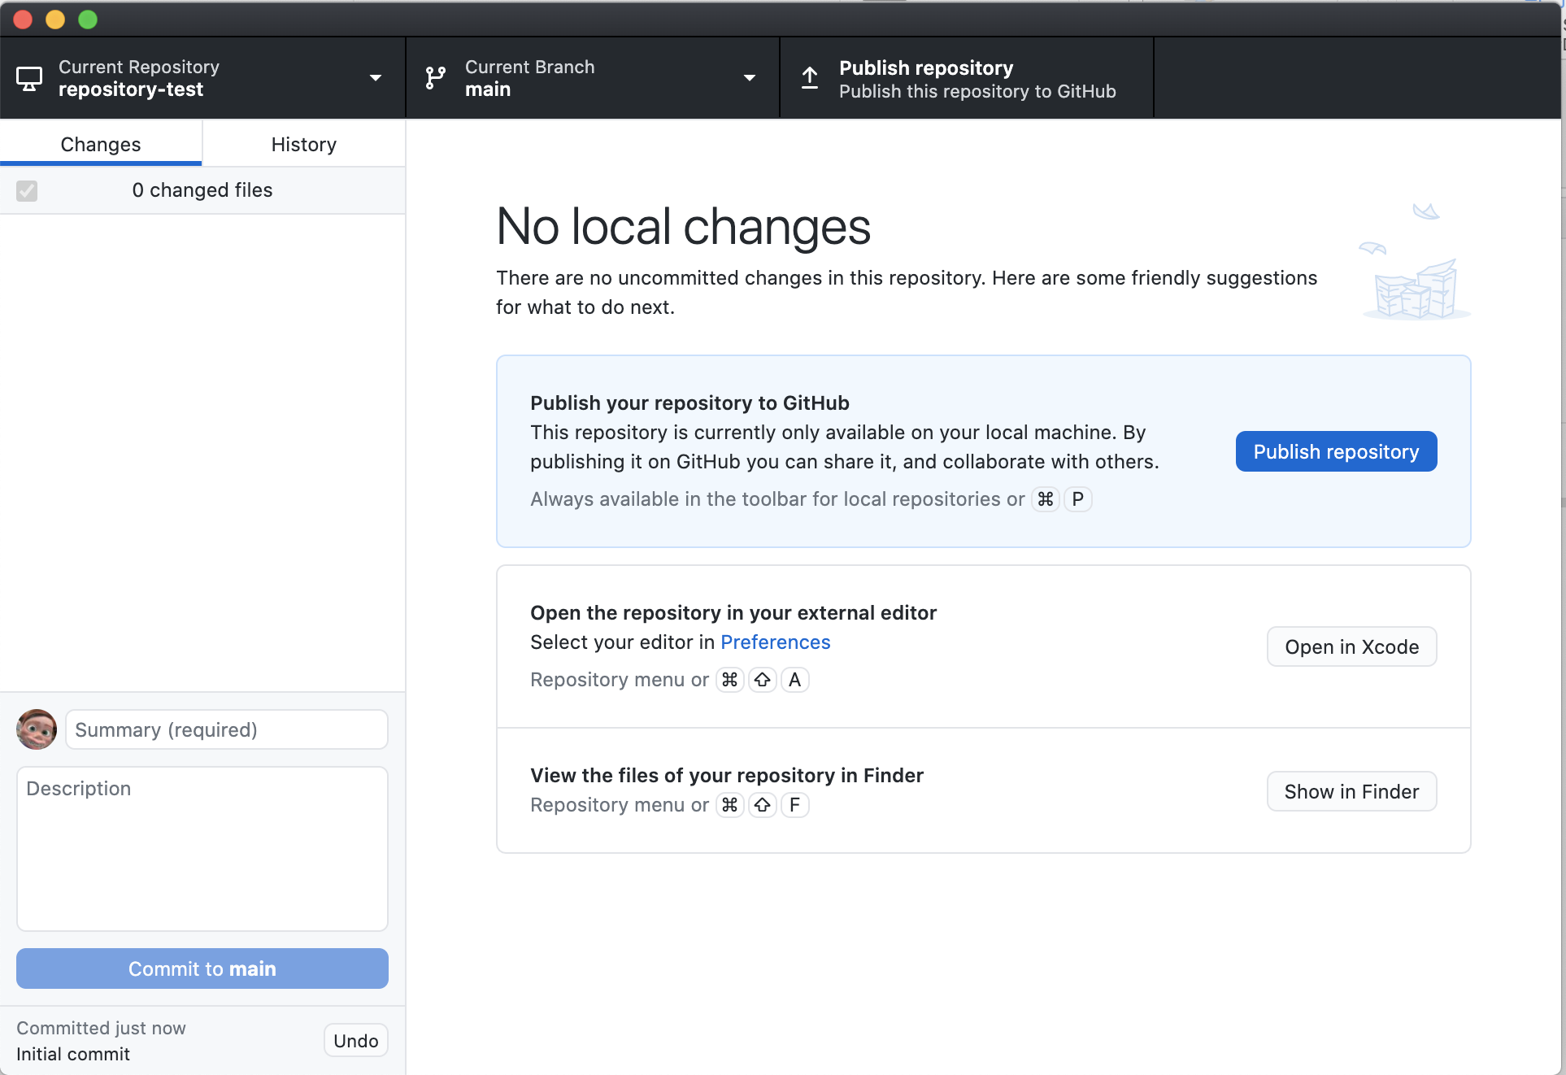
Publish your new Repository (I)

Slide 26
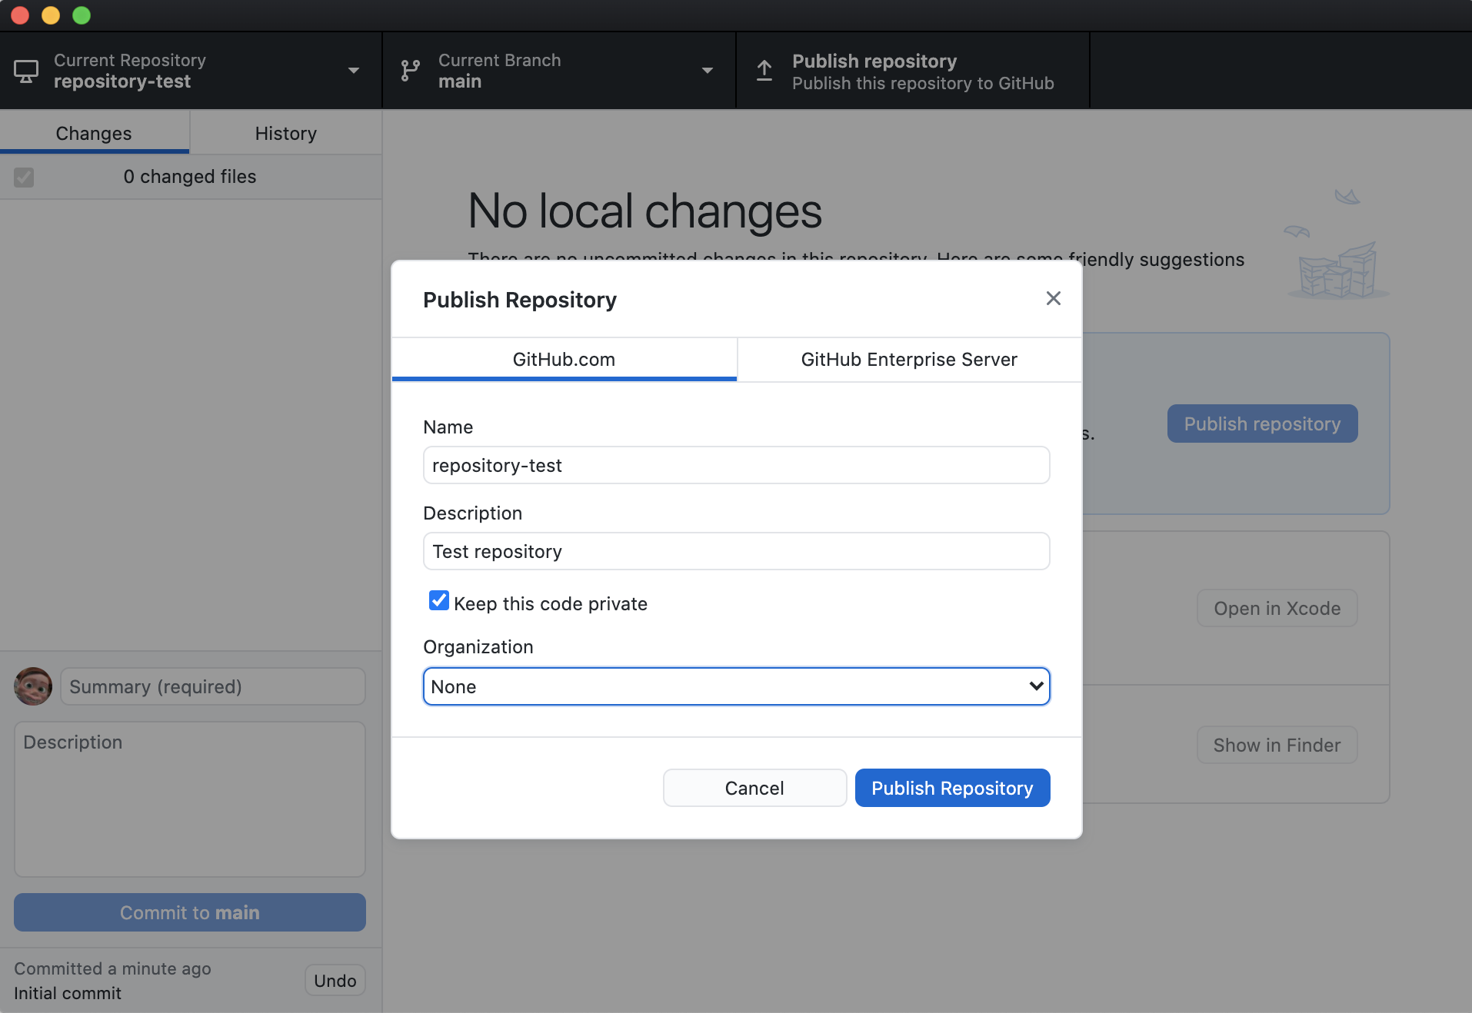
Publish your new Repository (II)

Slide 27
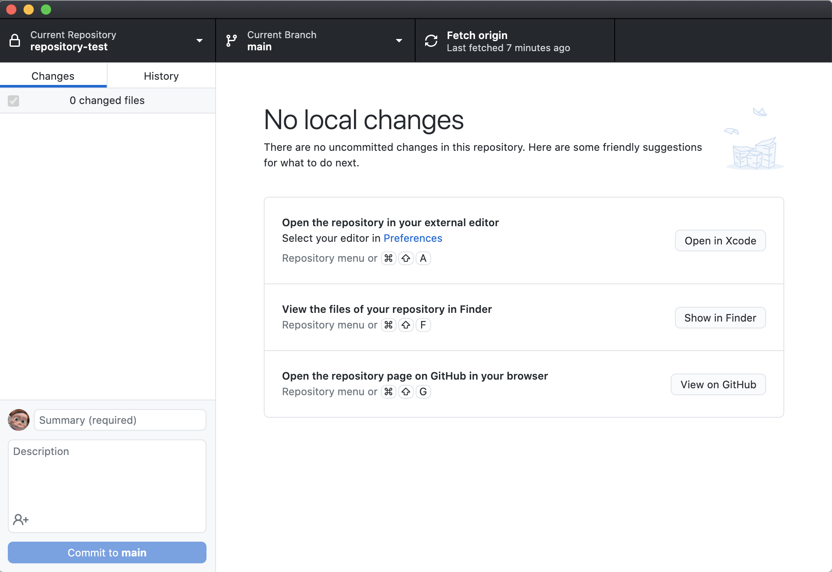
Publish your new Repository (III)

Slide 28
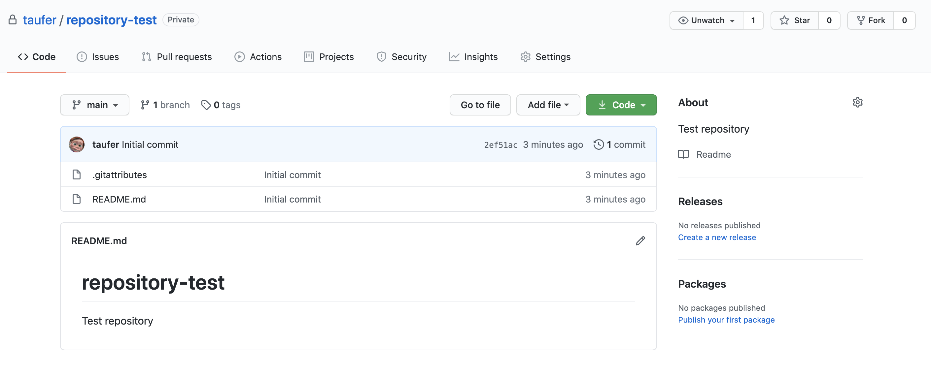
Publish your new Repository (IV)

Slide 29
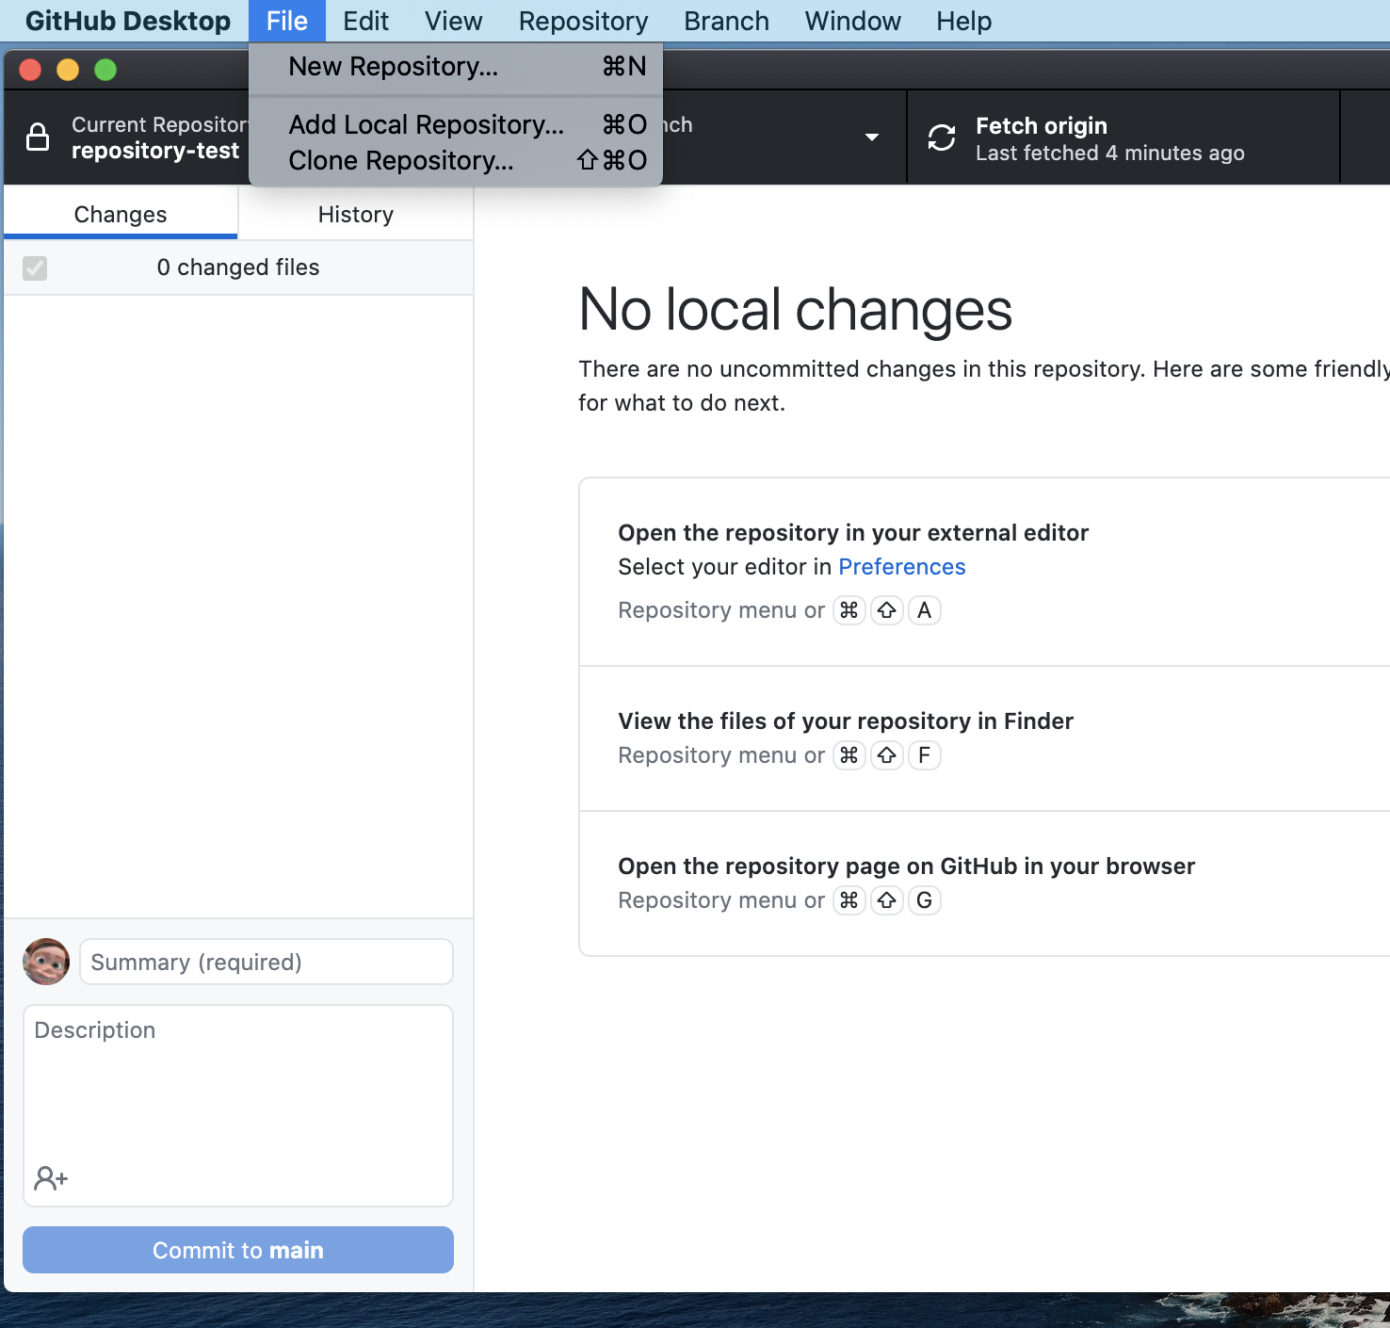
Clone the Course Repository (I)

Slide 30
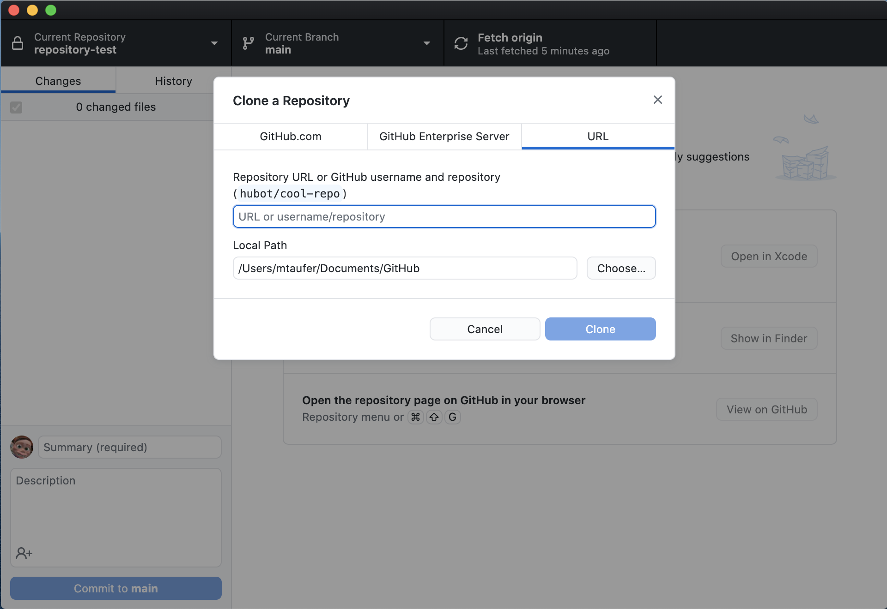
Clone the Course Repository (II)

Slide 31
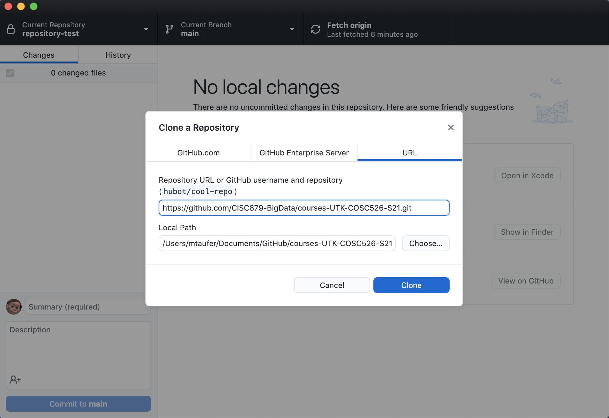
Clone the Course Repository (III)
https://github.com/CISC879-BigData/UTK-COSC426and526-S23.git

Slide 32
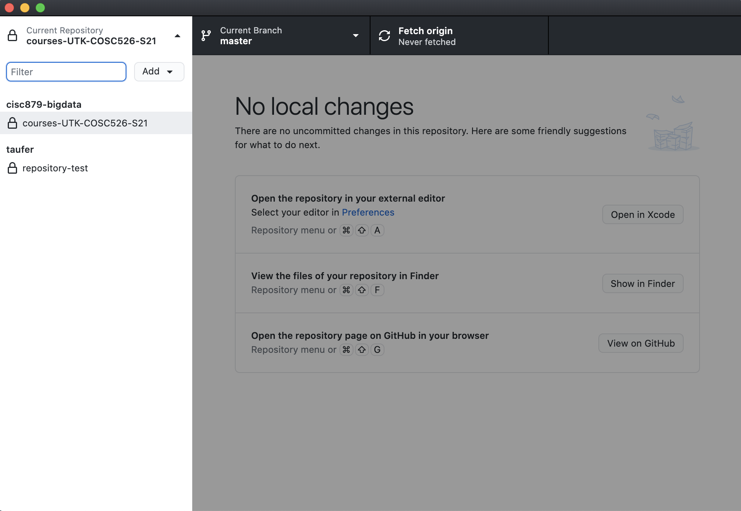
Clone the Course Repository (IV)

Slide 33
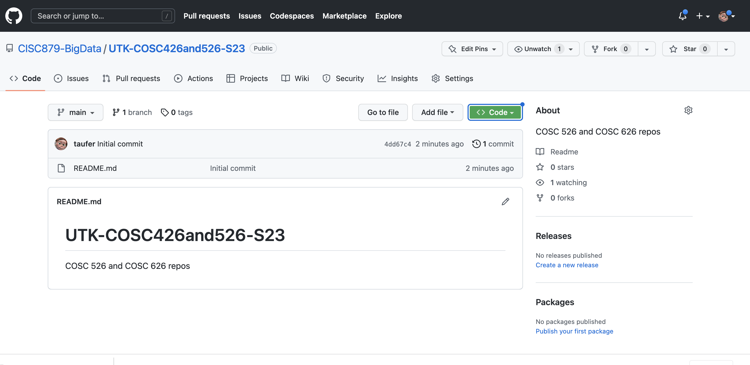
Clone the Course Repository (V)

Slide 34
Committing Changes to a Repository (I)

Slide 35
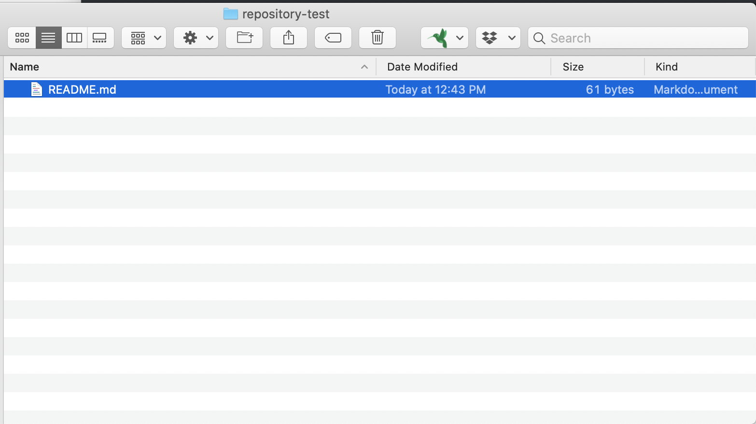
Committing Changes to a Repository (II)

Slide 36
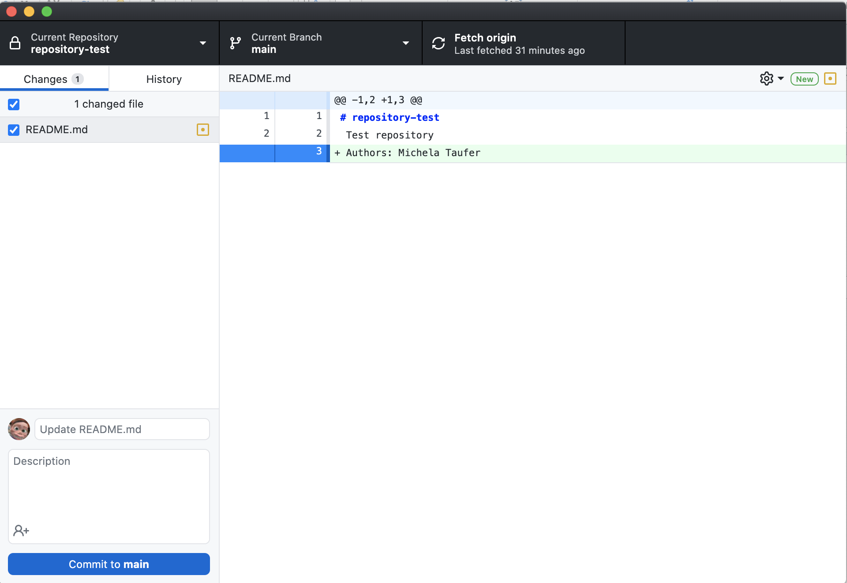
Committing Changes to a Repository (III)

Slide 37
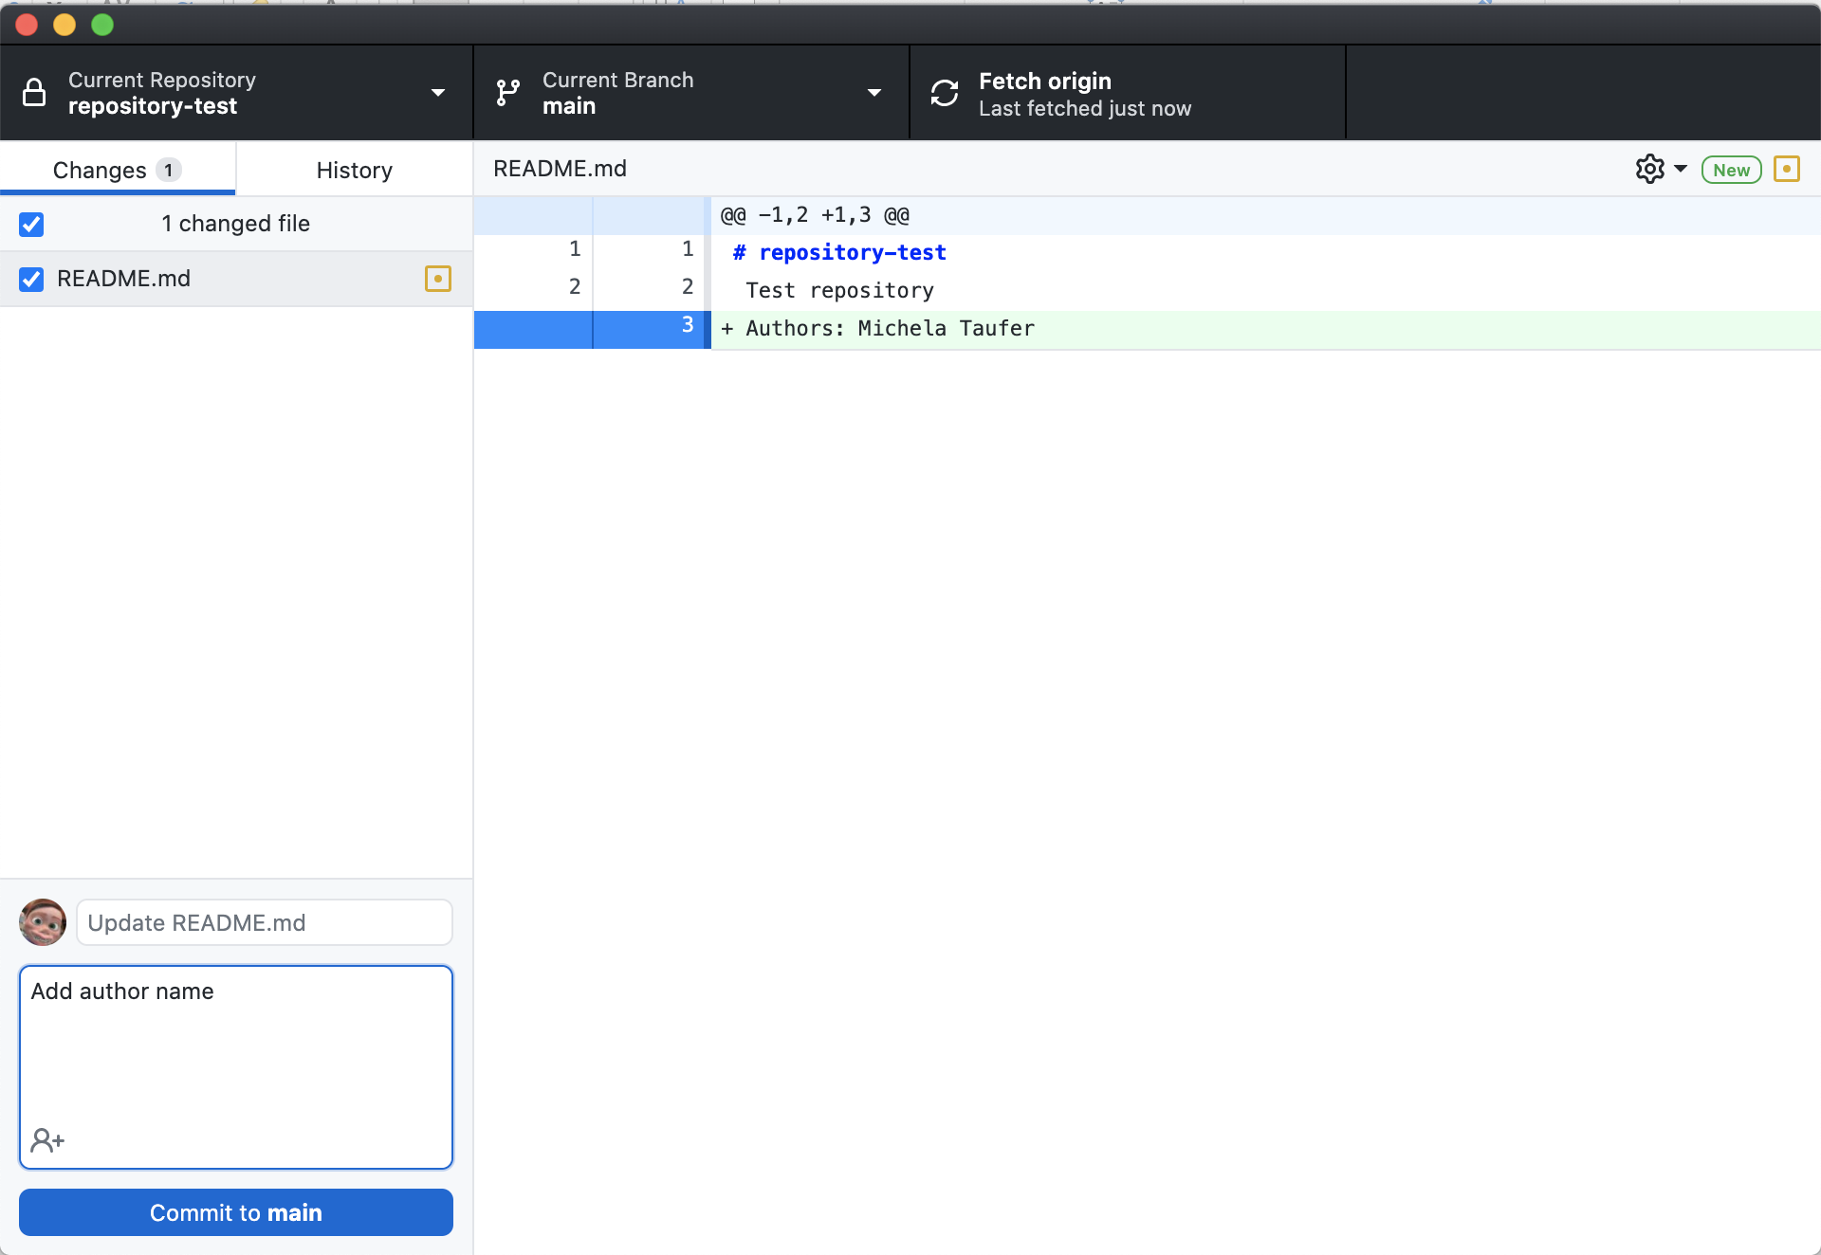
Committing Changes to a Repository (IV)

Slide 38
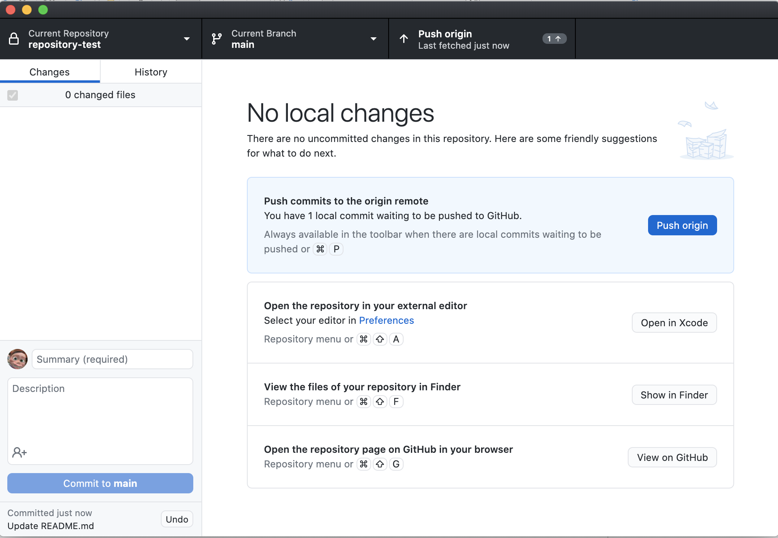
Committing Changes to a Repository (V)
Server
Repository
push
push
pull
pull
Repository
Repository
commit
commit
update
update
Working Copy
Working Copy
Workstation 1
Workstation 1

Slide 39

Committing Changes to a Repository (VI)

Slide 40
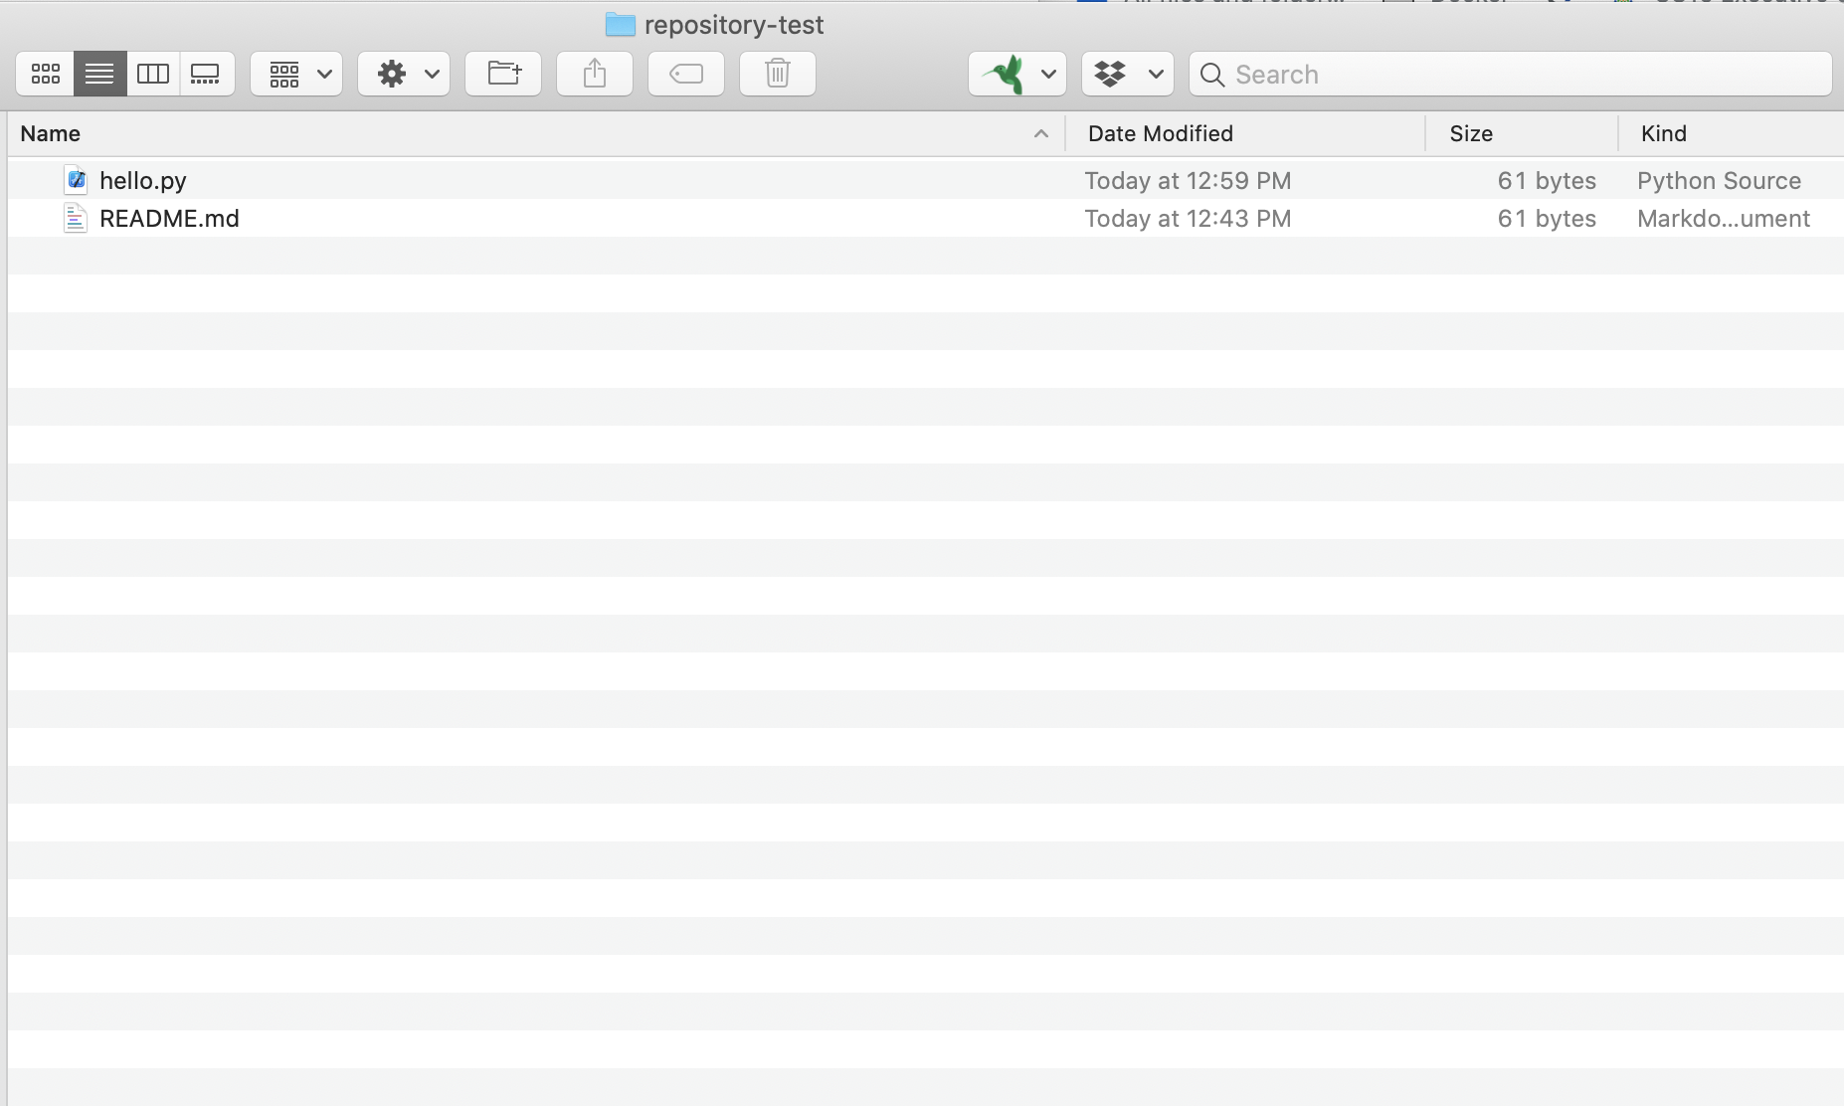
Add and Create new Files in a Repository (I)
# This program prints Hello, world!
print('Hello, world!’)

Slide 41
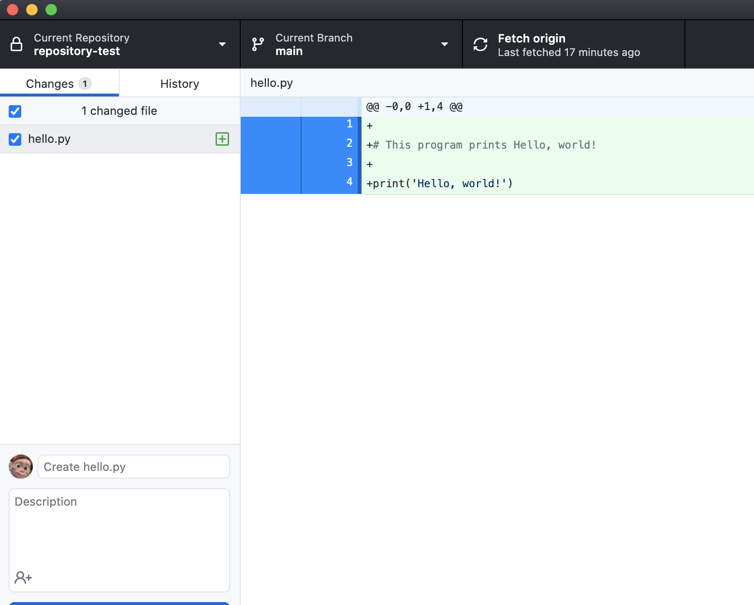
Add and Create new Files in a Repository (II)

Slide 42
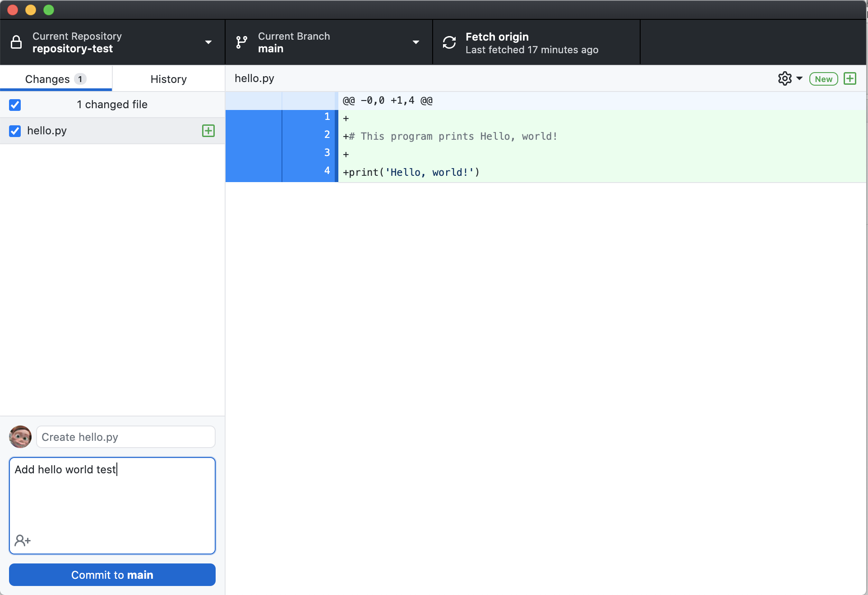
Add and Create new Files in a Repository (I)

Slide 43

Add and Create new Files in a Repository (I)
Server
Repository
push
push
pull
pull
Repository
Repository
commit
commit
update
update
Working Copy
Working Copy
Workstation 1
Workstation 1

Slide 44
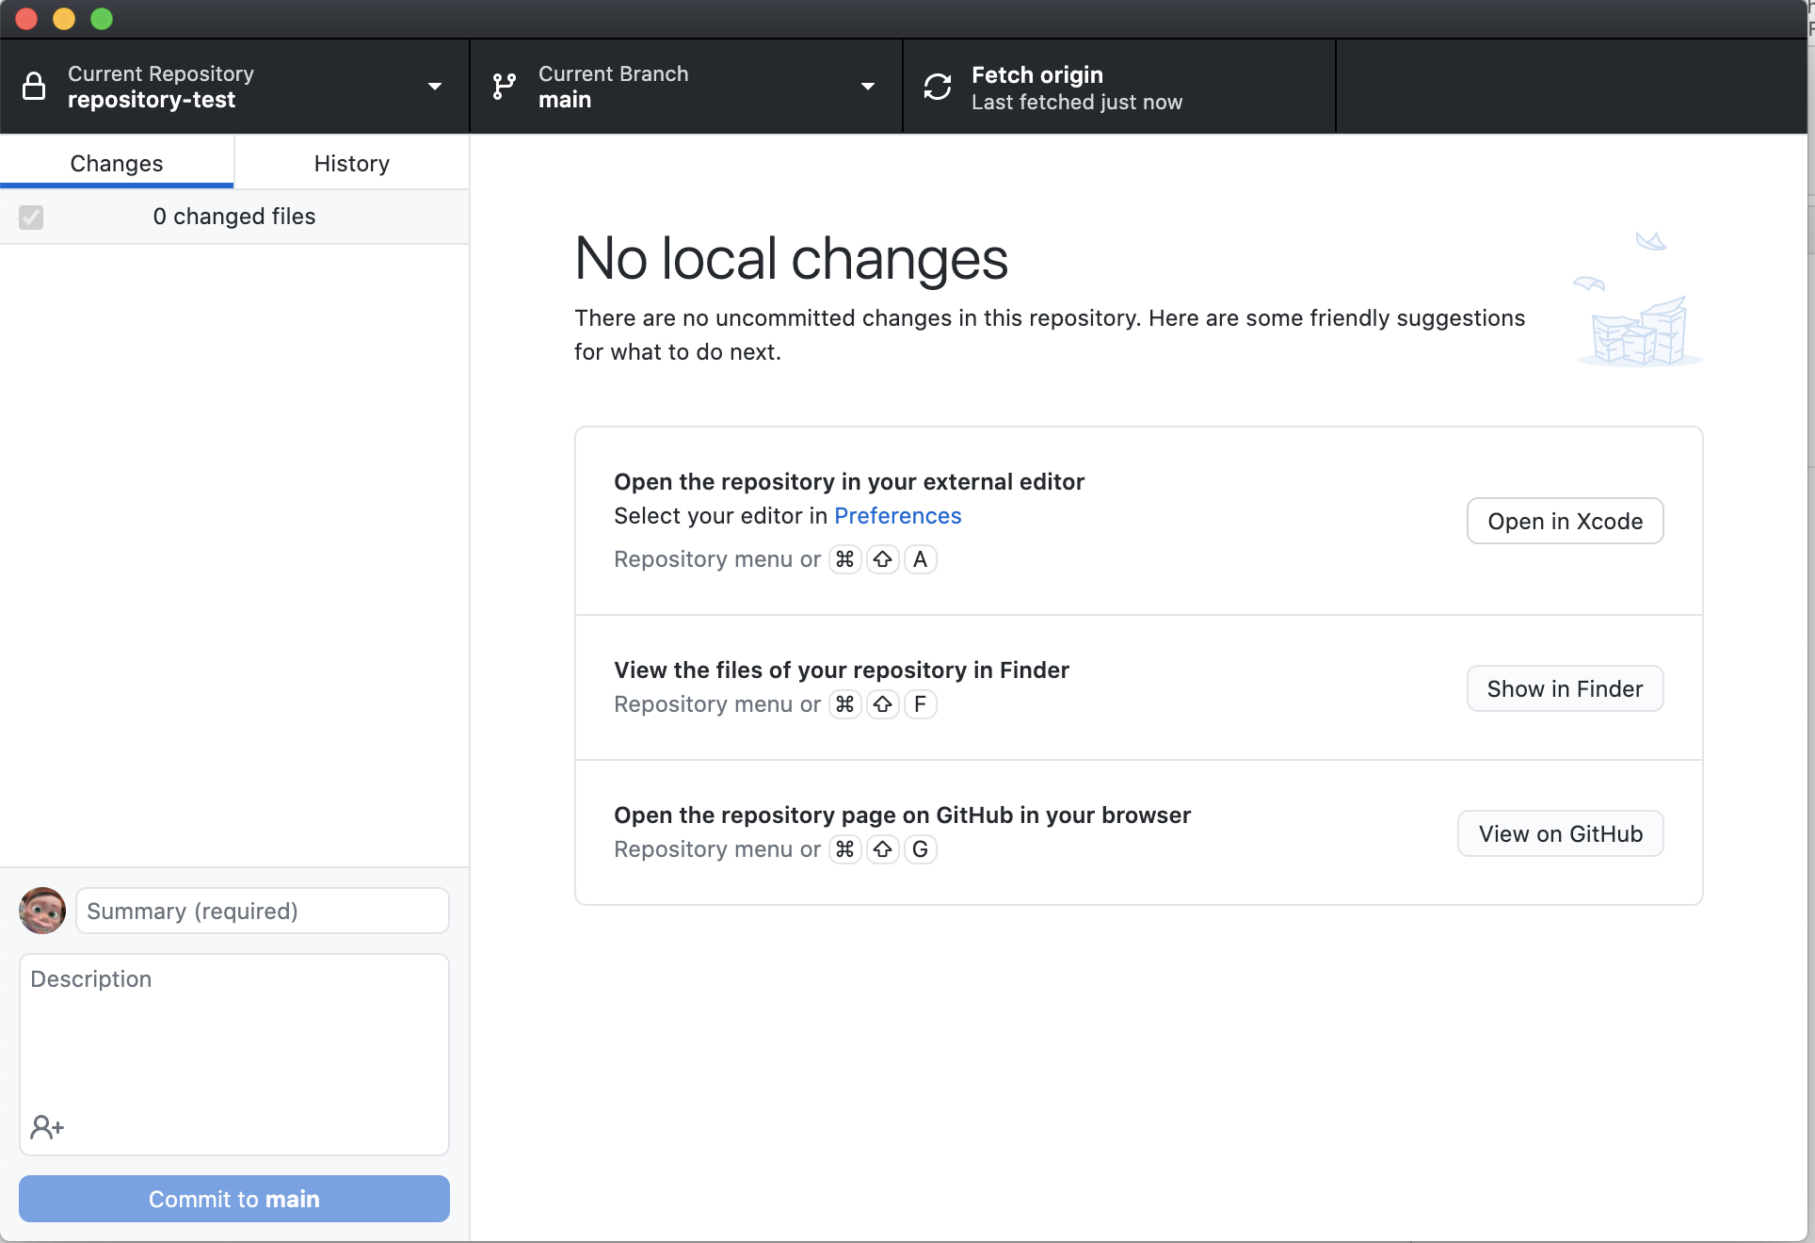
Add and Create new Files in a Repository (I)

Slide 45
Pull from Repository (I)
Not ready yet, bear with us ....

Slide 46
Command-line interface (CLI) This set of slides assumes that you have already installed git

Slide 47
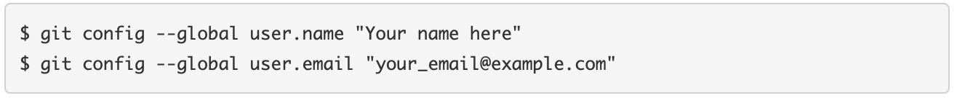
CLI: Your first time with git and GitHub (I)
CLI for git on Windows: https://gitforwindows.org
After installing git and GitHub desktop, if you are using CLI:
Set up git with your user name and email
Set up ssh on your computer
See if you have files ~/.ssh/id_rsa and ~/.ssh/id_rsa.pub.
If not, create such public/private keys:
Source : https://kbroman.org/github_tutorial/pages/first_time.html
47

Slide 48
CLI: Your first time with git and GitHub (II)
Copy your public key (the contents of the newly created id_rsa.pub file) into your clipboard – e.g., on Mac
Paste your ssh public key into your GitHub account settings
Go to your GitHub Account Settings
Click “SSH Keys” on the left.
Click “Add SSH Key” on the right.
Add a label (like “My laptop”) and paste the public key into the big text box.
From: https://kbroman.org/github_tutorial/pages/first_time.html
48

Slide 49
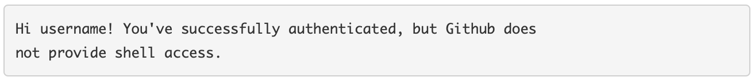
CLI: Your first time with git and GitHub (III)
In a terminal/shell, type the following to test it:
If it says something like the following, it worked:
From: https://kbroman.org/github_tutorial/pages/first_time.html
49

Slide 50
Use git and GitHub
The routine use of git involves just a few commands:
init
add and commit
push and pull
status
diff
50

Slide 51
A new repo from scratch
Create a directory to contain the project
$ mkdir YourRepos
Go into the new directory
Type git init
$ git init
Create a new file – ReadMe.md is a good start
$ echo "# YourRepos " >> ReadMe.md
Type git add to add the file
$ git add README.md
Type git commit to commit the file
$ git commit -m "first commit.”
At this point, your repos is ONLY local
Server
Repository
push
push
pull
pull
Repository
Repository
commit
commit
update
update
Working Copy
Working Copy
Workstation 1
Workstation 1
51

Slide 52
Keep the repo clean
Create a .gitignore file to indicate all of the files you don’t want to track in a (sub)directory
$ git add .gitignore
Create a .gitignore_global file to indicate the files you don’t want to track for the entire directory. You have to tell git about the global .gitignore
$ git add .gitignore_global
$ git config --global core.excludesfile ~/.gitignore_global
52
Notes:
*~
.*~
.DS_Store
.Rhistory
.RData

Slide 53
.gitignore_global and .gitignore
*~
.*~
.DS_Store
.Rhistory
.RData
53

Slide 54
Create a Repository (I) repeat ….

Slide 55
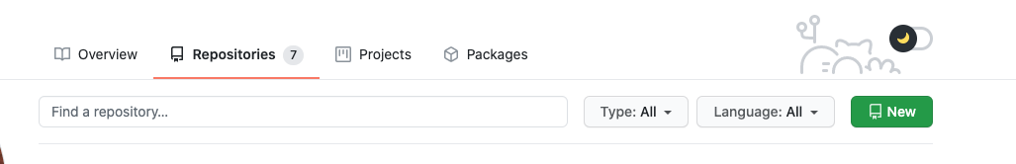
Connect new repo to GitHub (I)
Go to GitHub
Log in to your account
Click the ”New” repository button in the top-right
Click the “Create repository” button
Back to your terminal:
$ git remote add origin https://github.com/YourAccount/YourRepos.git
$ git push -u origin master
55

Slide 56
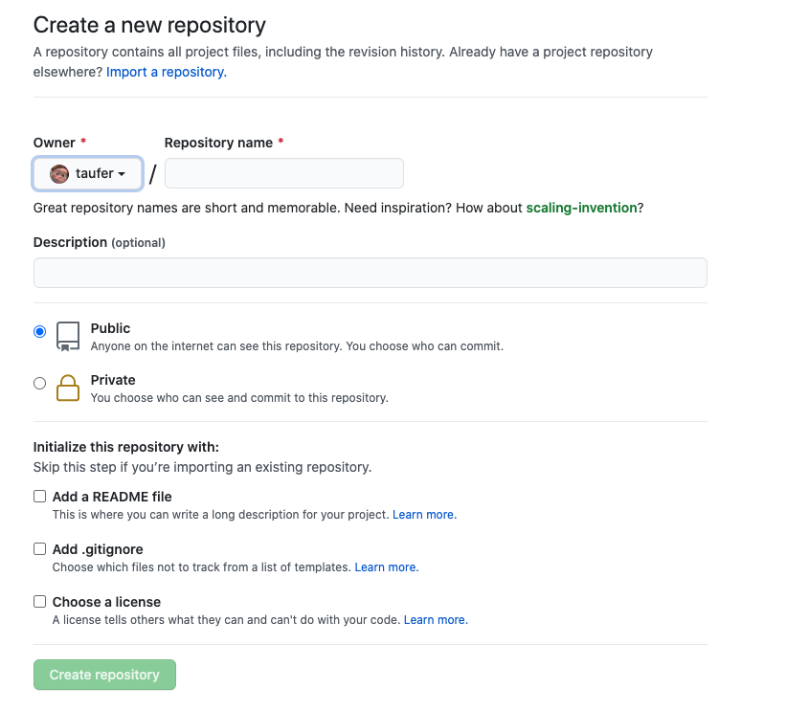
56

Slide 57
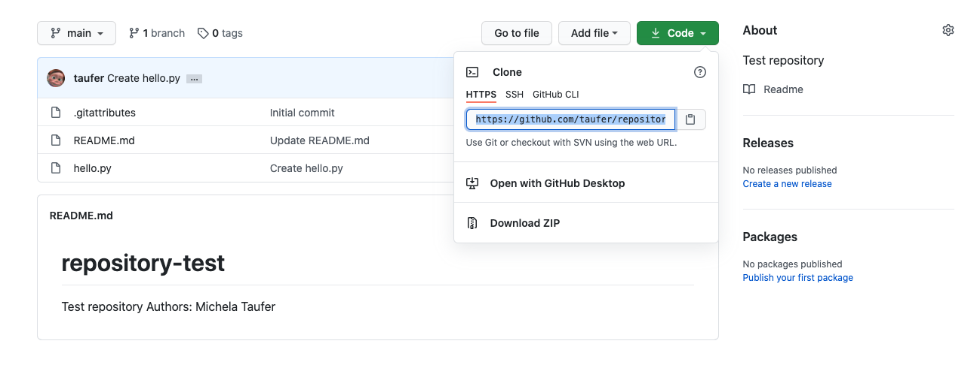
Connect new repo to GitHub (II)
Clone a new or old repository
git clone https://github.com/YourAccount/YourRepos.git
57

Slide 58
Add and commit (I)
Add completely new files as well as “add” modifications to files that already exist in the repository (e.g., README.md)
$ mkdir Lecture01
$ touch Lecture01/README.md
$ emacs README.md
$ git add Lecture01 Lecture01/README.md README.md
From: https://kbroman.org/github_tutorial/pages/routine.html
58

Slide 59
Add and commit (II)
Use git commit to add the modifications to the repo
$ git commit OR $ git commit -m “Message: 40 / 60 characters”
Server
Repository
push
push
pull
pull
Repository
Repository
commit
commit
update
update
Working Copy
Working Copy
Workstation 1
Workstation 1
From: https://kbroman.org/github_tutorial/pages/routine.html
59

Slide 60
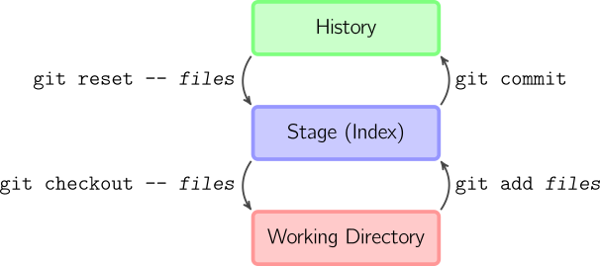
Add and commit (II)
$ git add <filename>
$ git add
$ git commit -m "Commit message”
Server
Repository
push
push
pull
pull
Repository
Repository
commit
commit
update
update
Working Copy
Working Copy
Workstation 1
Workstation 1
60

Slide 61
Push to and pull from GitHub
After any git add and git commit commands, changes are in the HEAD of your local working copy
To push committed changes to your remote repository - GitHub, type:
$ git push
To pull committed changes from your remote repository - GitHub, type:
$ git pull
Server
Repository
push
push
pull
pull
Repository
Repository
commit
commit
update
update
Working Copy
Working Copy
Workstation 1
Workstation 1
From: https://kbroman.org/github_tutorial/pages/routine.html
61

Slide 62
Differences in GitHub
To extract differences and changes, type:
$ git diff
To extract changes in one specific file, type
$ git diff README.md
From: https://kbroman.org/github_tutorial/pages/routine.html
62

Slide 63
More about GitHub (Optional)

Slide 64
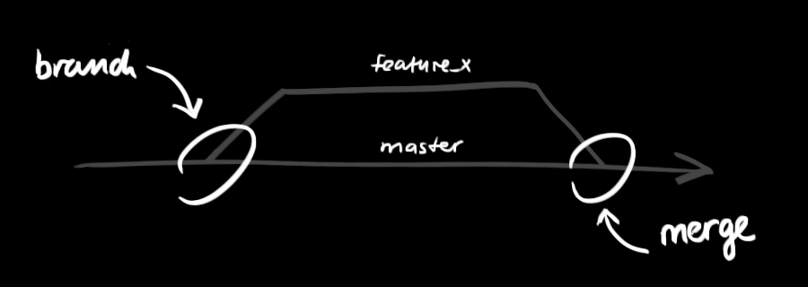
Branching and branches
Branches are used to develop features isolated from each other
The master branch is the "default" branch when you create a repository
Use other branches for development and merge them back to the master branch upon completion
64

Slide 65
Branching and branches
Create a new branch named "feature_x" and switch to it:
$ git checkout -b feature_x
Switching back to master:
$ git checkout master
Delete the feature branch:
$ git branch -d feature_x
Pushing a branch for others to use:
$ git push origin <branch>
65

Slide 66
Syncing & Merging
Updating your local repository to the newest commit:
git pull
Merge another branch into your active branch (e.g., master):
git merge <branch>
After resolving merge conflicts, you need to mark them as merged:
git add <filename>
You can also preview them by using the following:
git diff <source_branch> <target_branch>
66

Slide 67
Undoing
Unstage changes:
git reset HEAD <file>...
Discard changes in the working directory:
git checkout -- <file> …
67

Slide 68
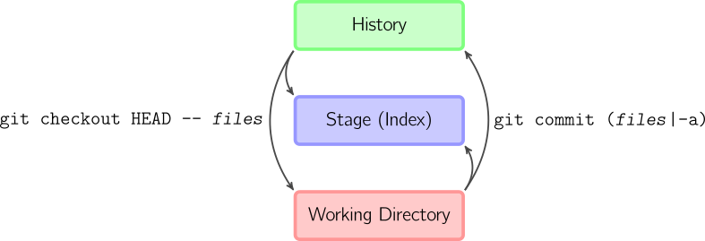
Combining Commands
Add + Commit:
git commit –a
Equivalent to running git add on all filenames that existed in the latest commit and then running git commit
Reset + Checkout:
git checkout HEAD -- <file> …
Copies files from the latest commit to both the stage and the working directory
68

Slide 69
Python, Anaconda, and Jupyter Notebook
69

Slide 70
Python and Anaconda
Python: It is Python 3+
Anaconda: Python distribution
Include many popular packages by default, including Jupyter notebook
Make installing additional packages easy
Your task:
Install Anaconda and launch the Jupyter notebook

Slide 71
Install Anaconda
To install Anaconda (Distribution, not Enterprise or Cloud), follow the installation instructions for your operating system:
Windows
https://docs.anaconda.com/anaconda/install/windows/
Mac
https://docs.anaconda.com/anaconda/install/mac-os/
Linux
https://docs.anaconda.com/anaconda/install/linux/

Slide 72
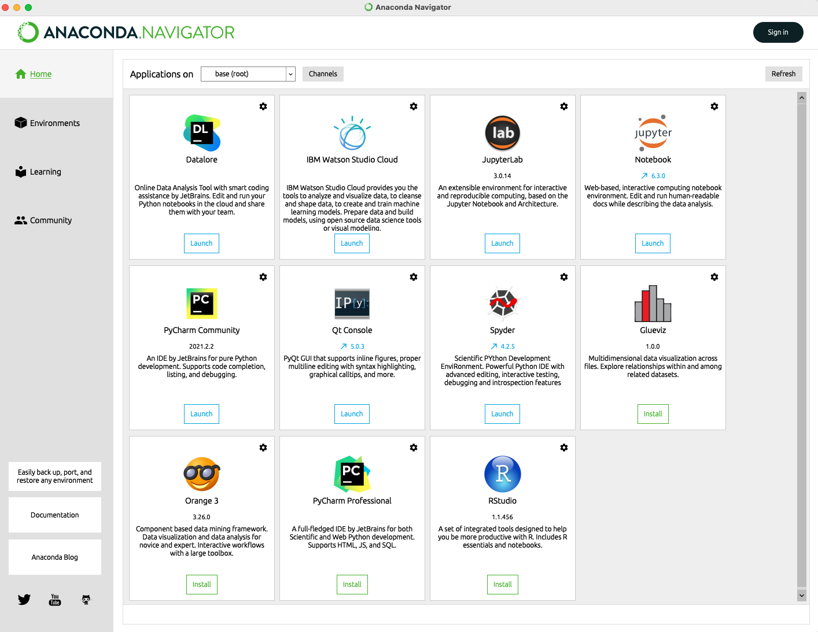
Anaconda Navigator

Slide 73
Anaconda Navigator

Slide 74
Jupyter Notebook
Jupyter notebook: Our notebook for data analytics
Programming in a browser
Create code in a cell – code in edit mode
Run code in a cell – code in command mode
Write text before and after code cells – markdown
Your task:
Launch Jupyter from Anaconda GUI (or command line)

Slide 75
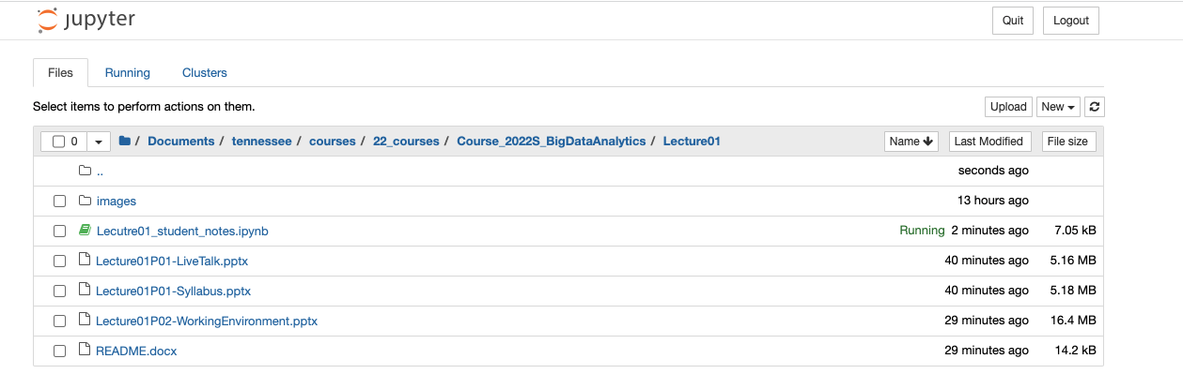
Open your directory

Slide 76
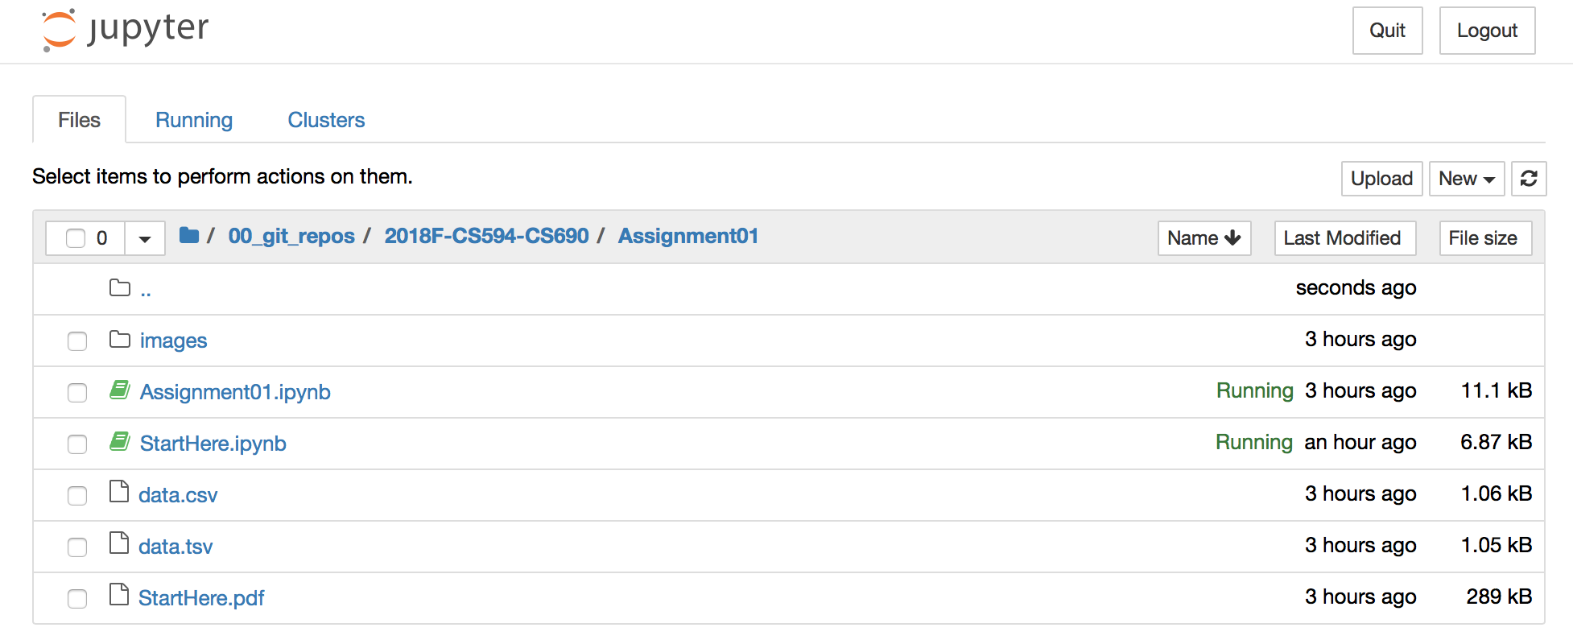
Open your assignment directory

Slide 77
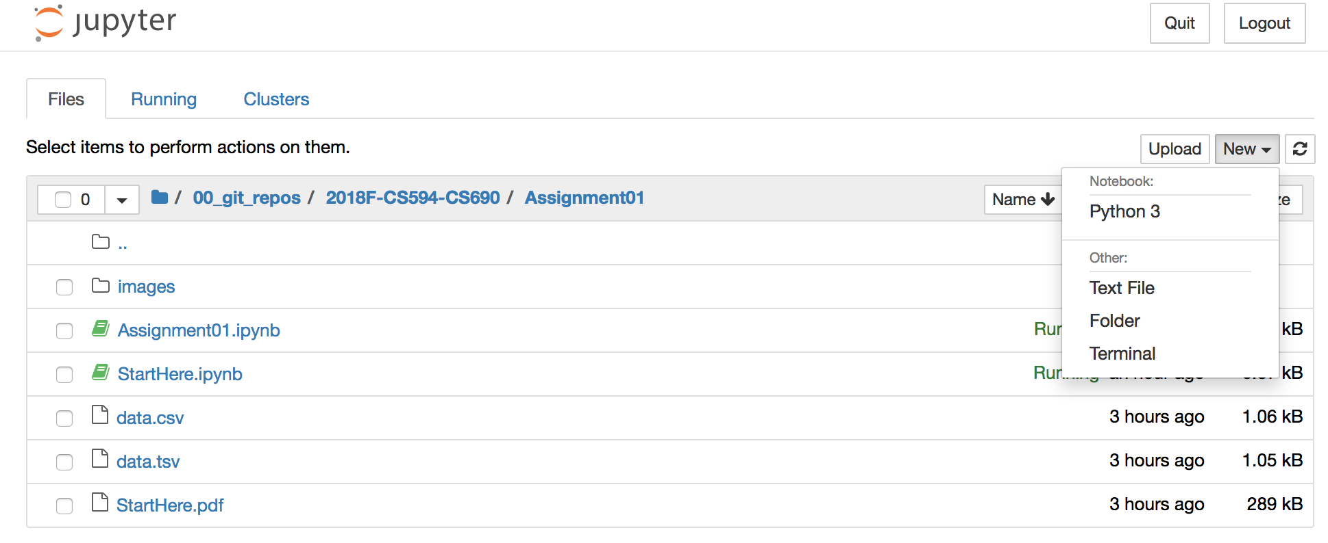
Create your own notebook

Slide 78
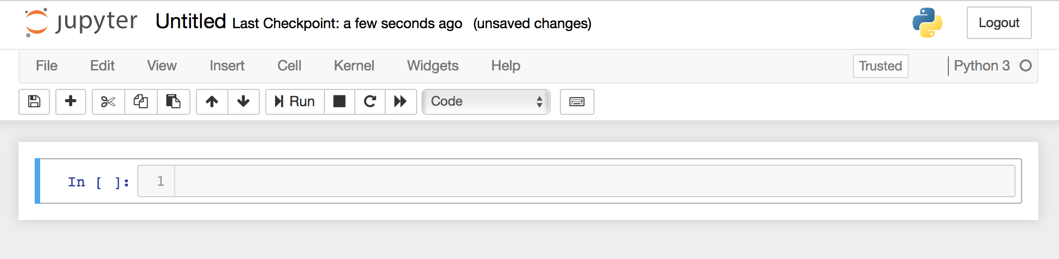
Create your own notebook

Slide 79
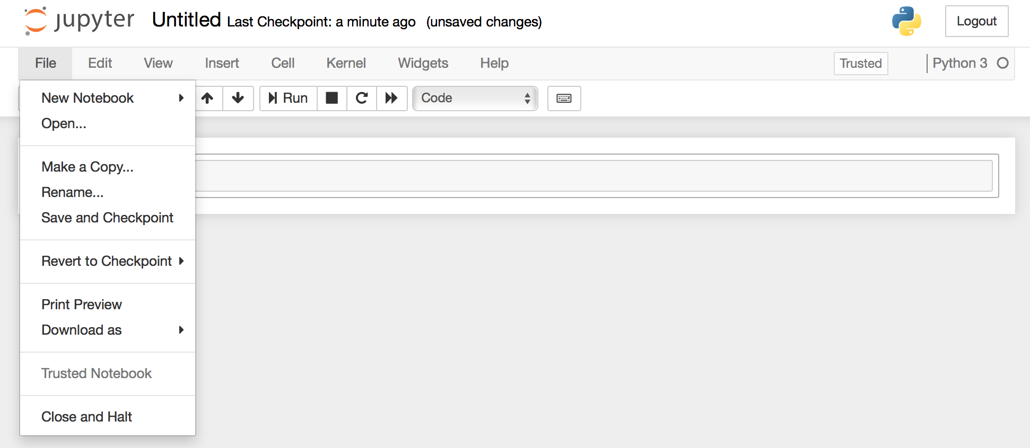
Create your own notebook

Slide 80
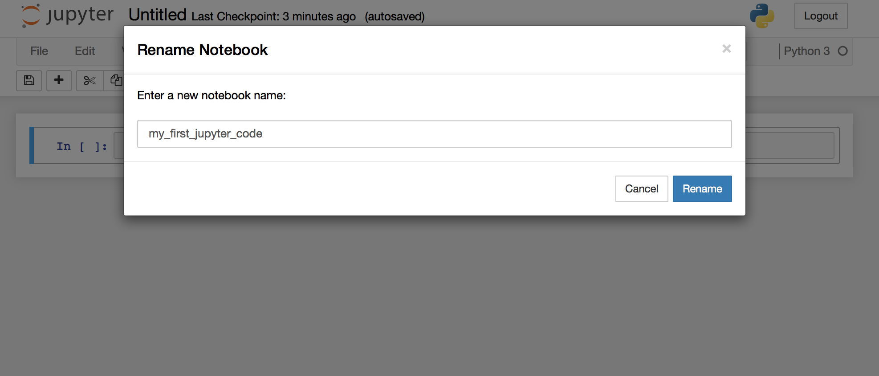
Rename the file

Slide 81
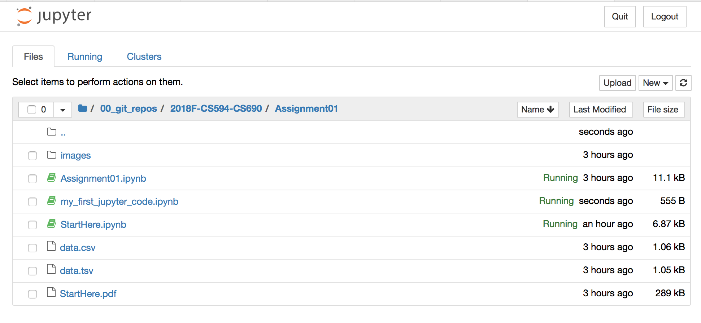
Create your own notebook

Slide 82
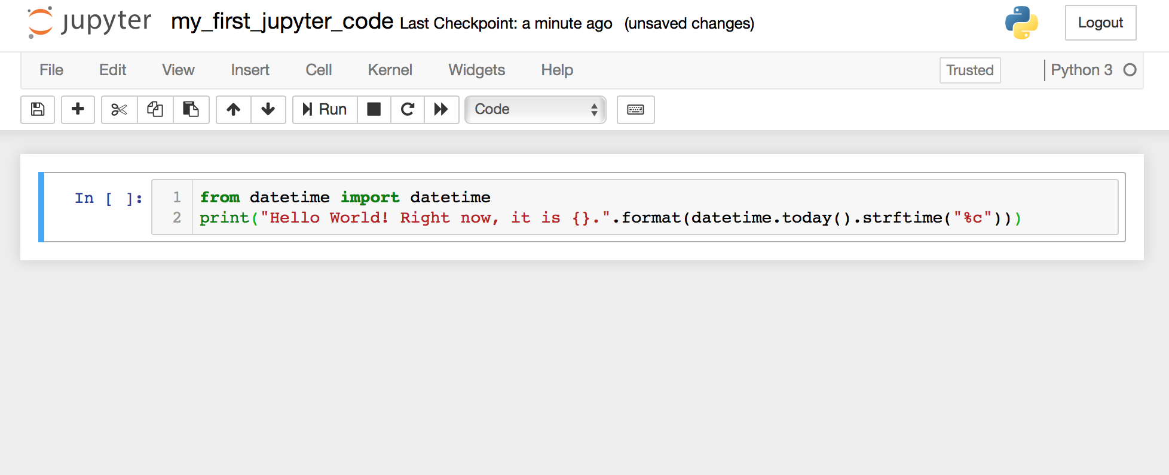
Create a code cell

Slide 83
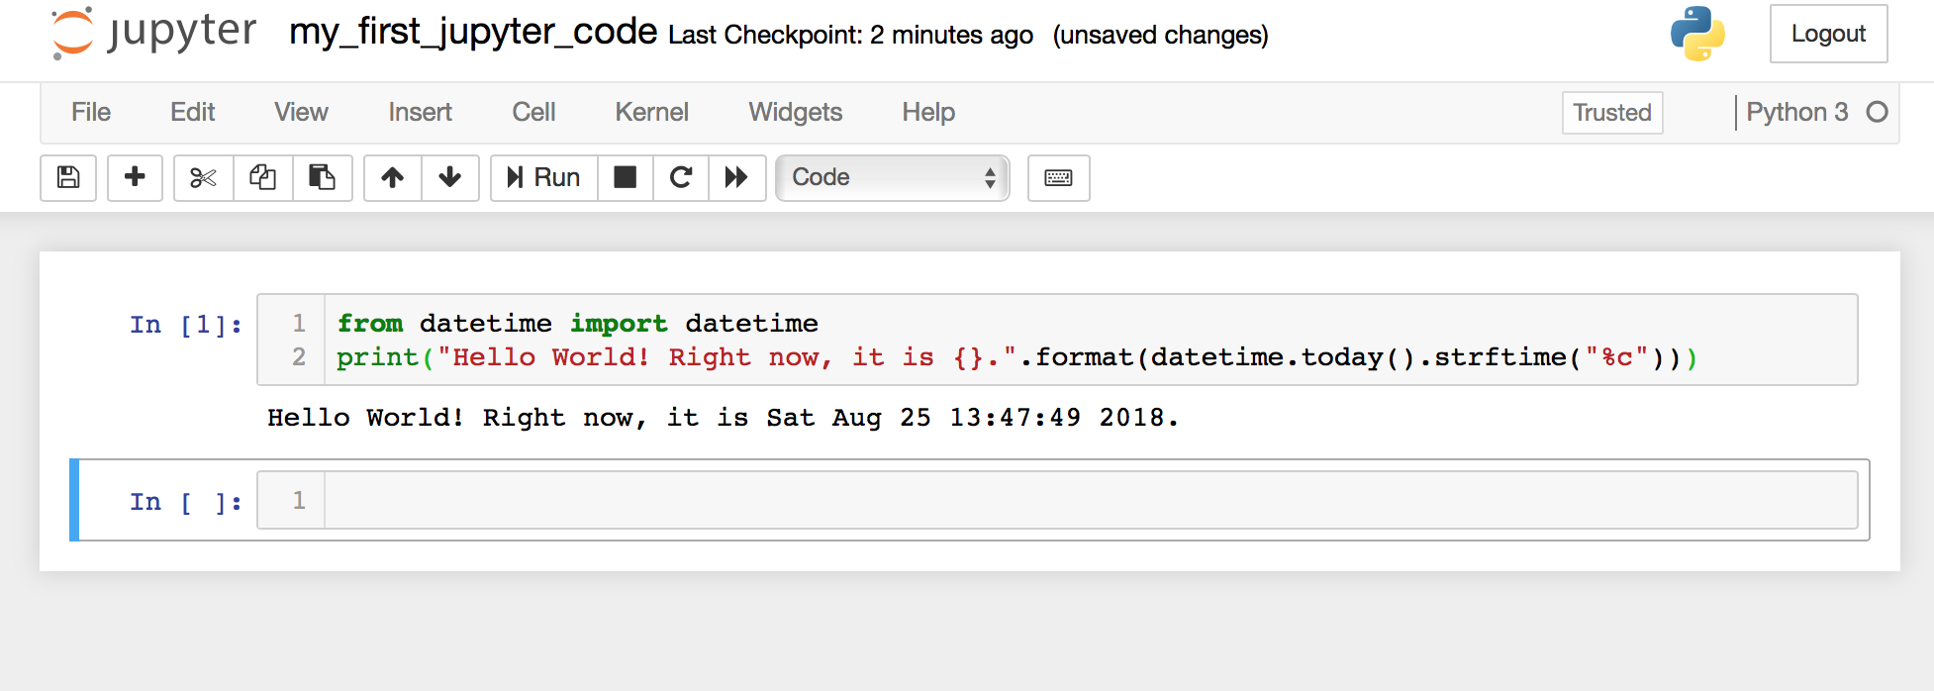
Run your code code

Slide 84
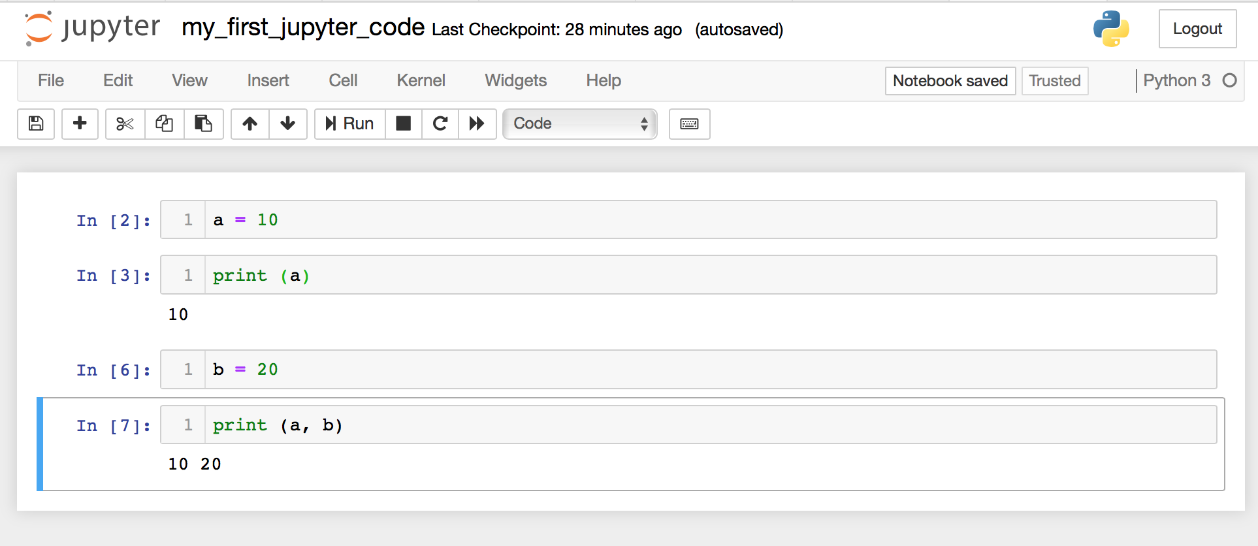
Propagations: from cell to cell

Slide 85
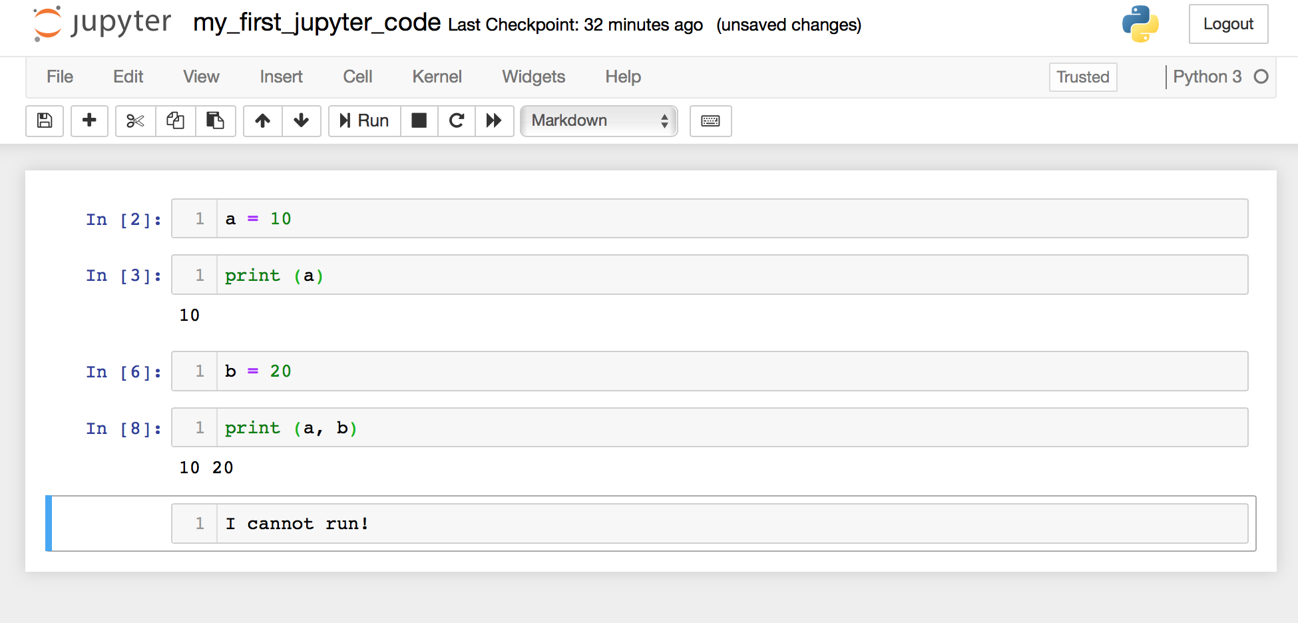
Add text to your notebook

Slide 86
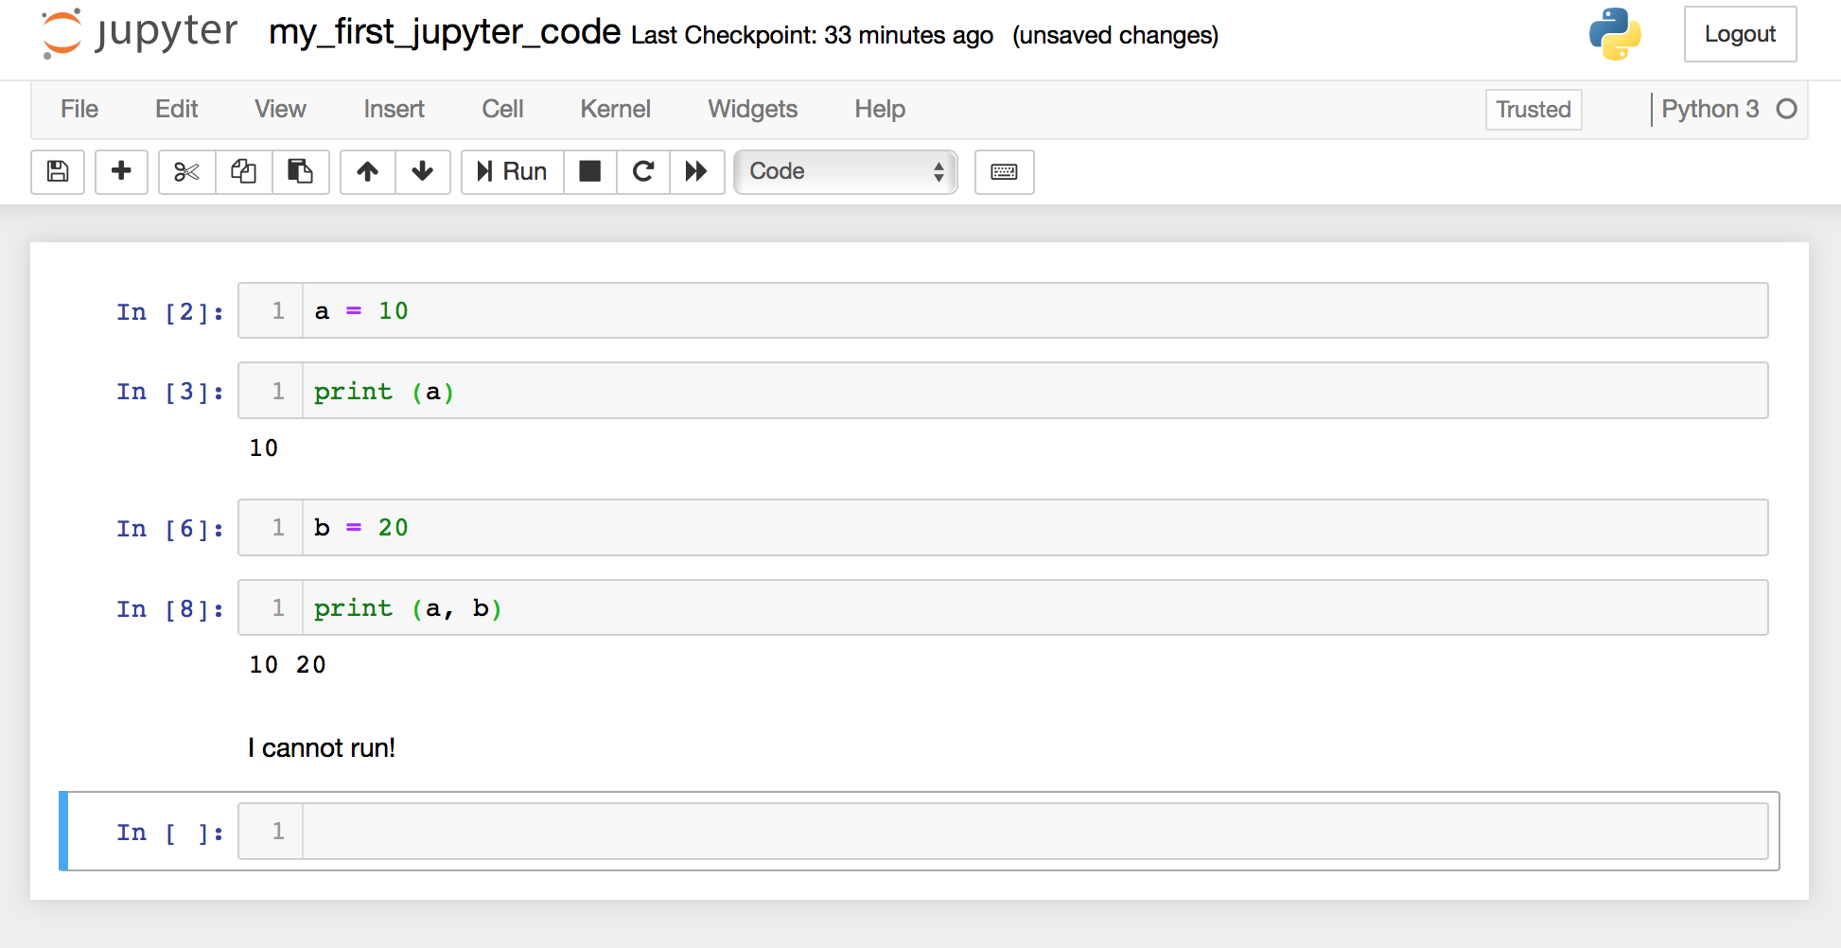
Add text to your notebook

Slide 87
Course Repository

Slide 88
Clone our Class Repository
Using either the GitHub Desktop app or the git CLI, clone the class repo:
https://github.com/CISC879-BigData/UTK-COSC426and526-S23.git

Slide 89
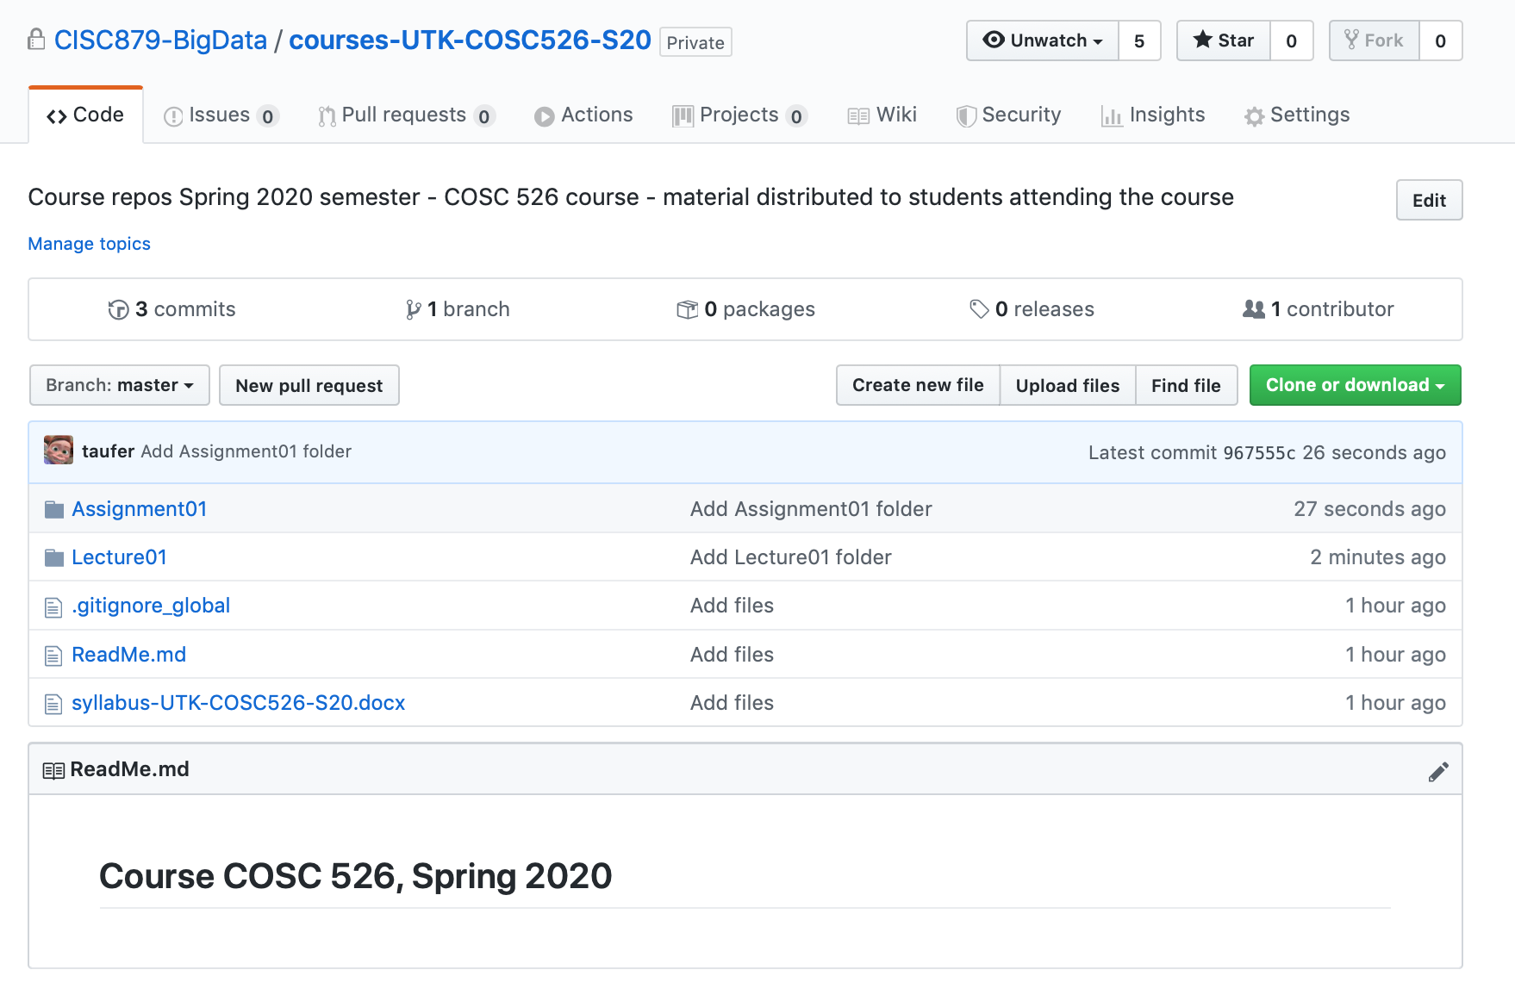
Clone the course repository
https://github.com/CISC879-BigData/UTK-COSC426and526-S23

Slide 90
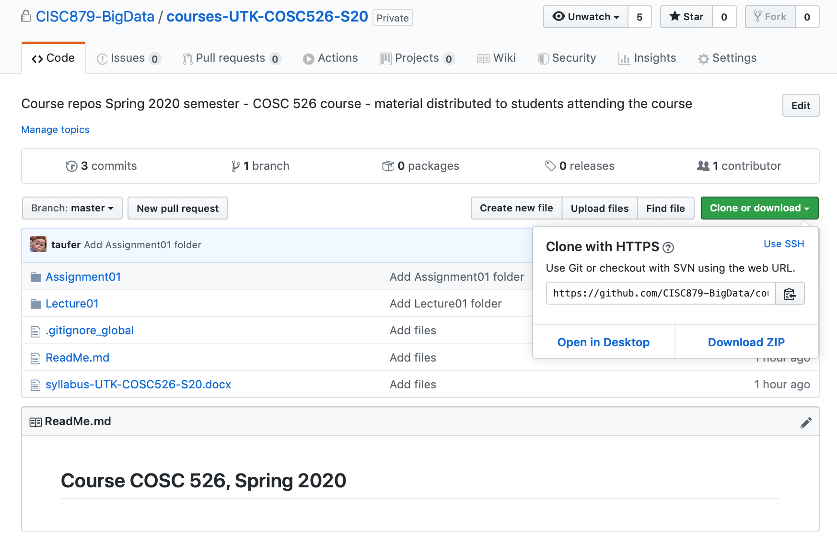
Clone the course repository

Slide 91
Open from CLI
$ git clone https://github.com/CISC879-BigData/UTK-COSC426and526-S23.git

Slide 92
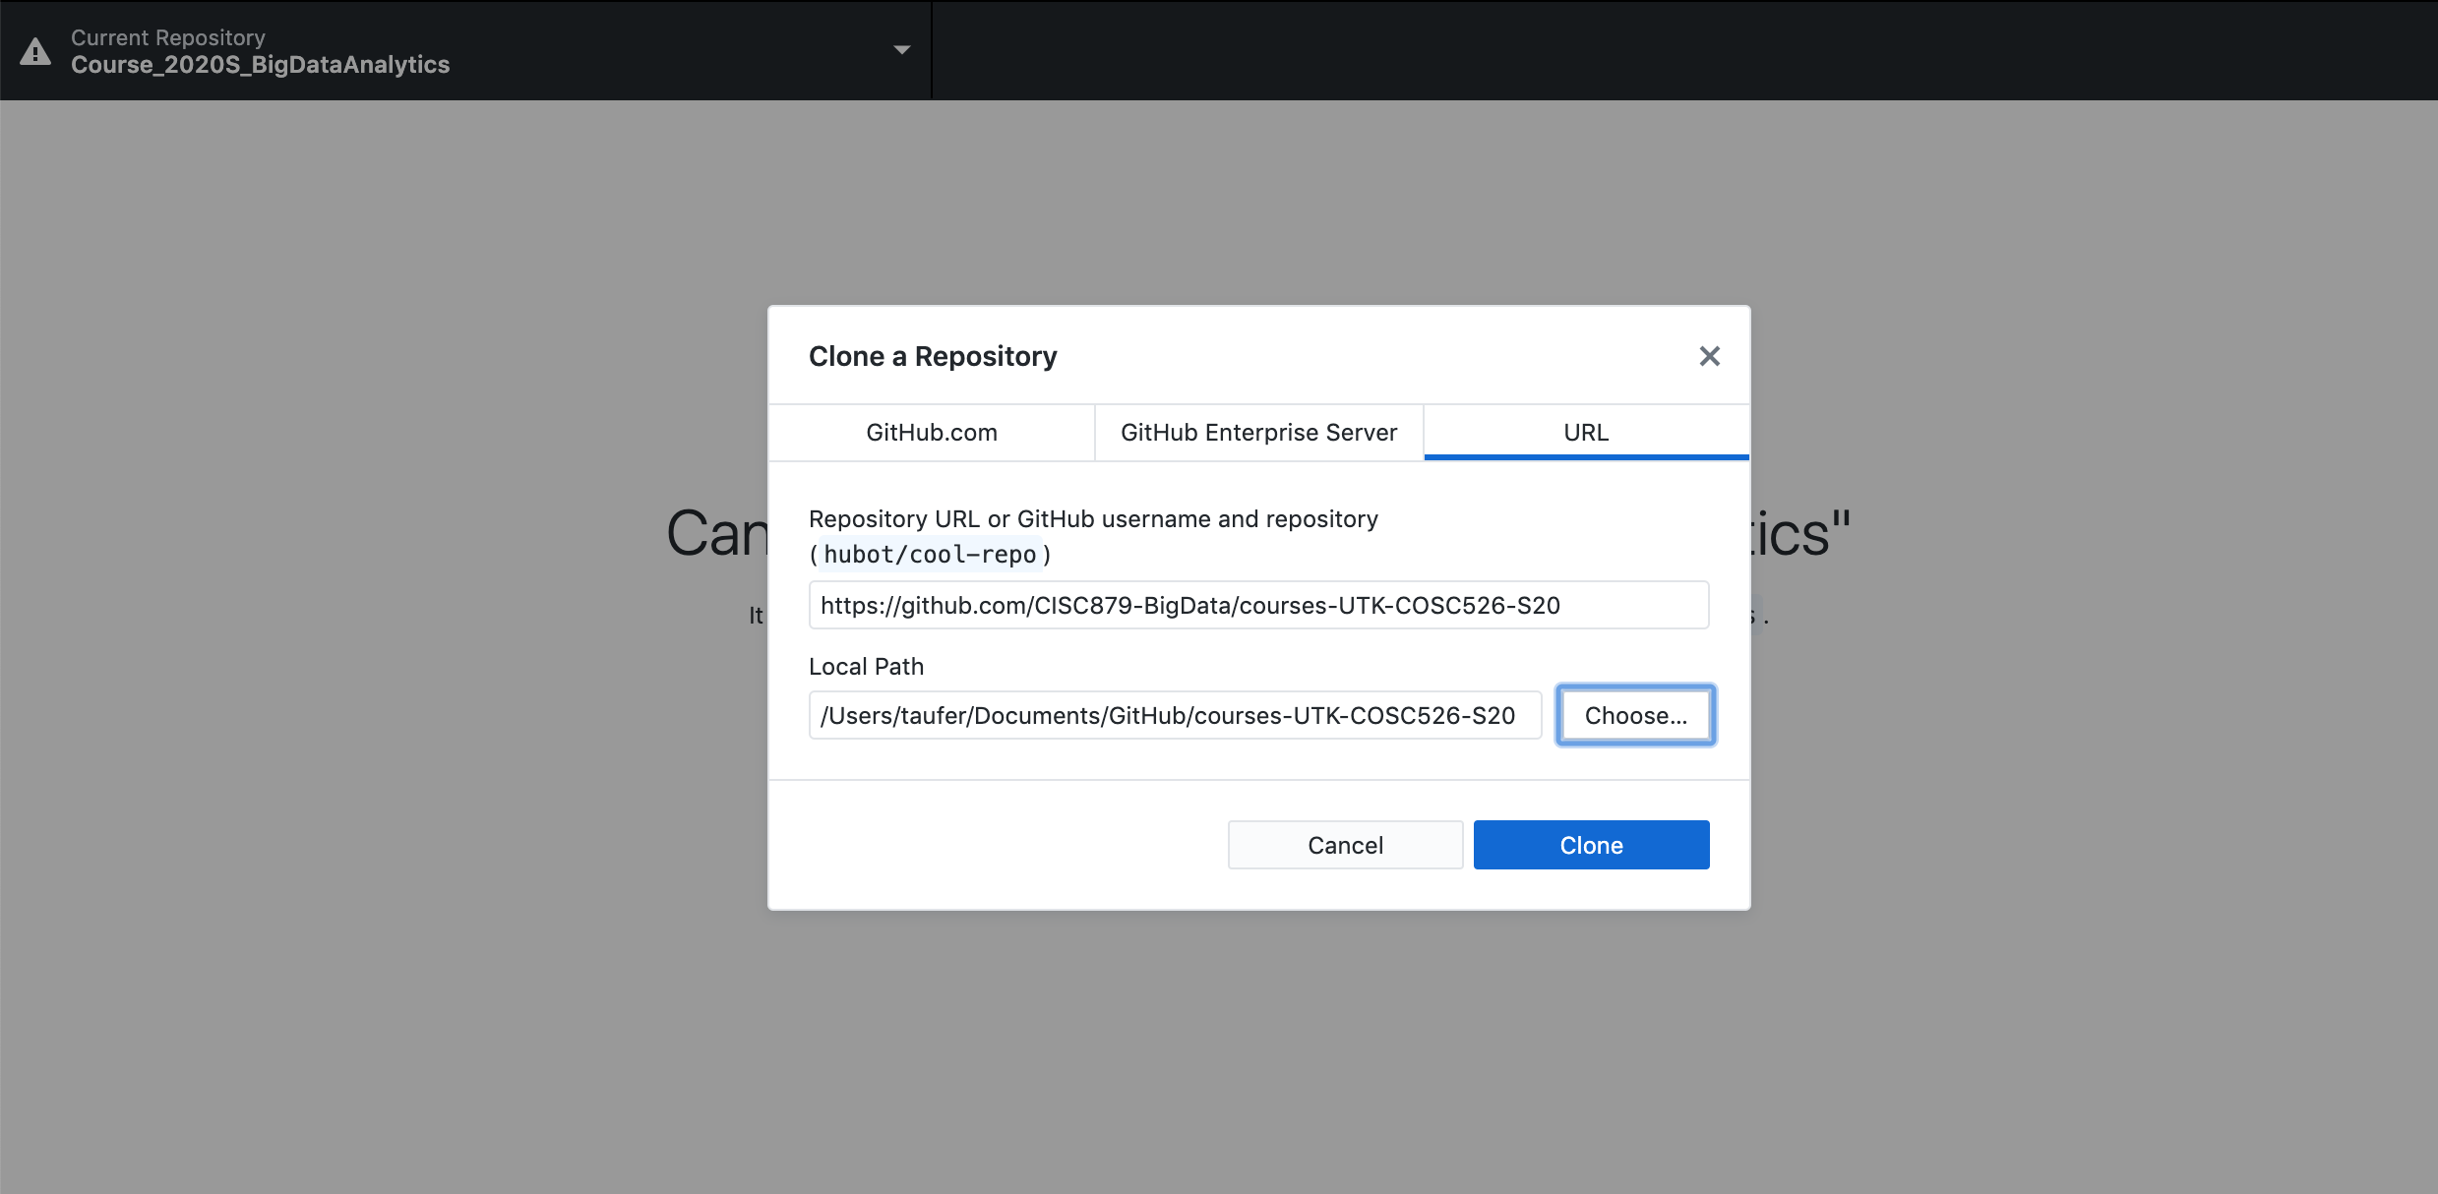
Open from GitHub Desktop

Slide 93
Breakout Session

Slide 94
Breakout Sessions
Join one of several breakout sessions:
Breakout sessions targeting environment setting: ”I need help with my environment setting.”
Install git, GitHub, Anaconda
Breakout sessions to ask questions on Assignment 1: “I need help with Assignment 1. “
Achieve these goals at the end of this working session:
Your laptop is correctly set up for your assignments during the rest of the semester
You know how to solve Assignment 1 and can submit it by the end of today

